Slide 1
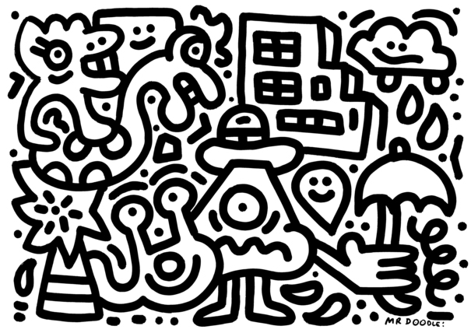
doo·dle
ˈdo͞odl/Submit
verb
1. scribble absentmindedly.
"he was only doodling in the margin"
noun
1. a rough drawing made absentmindedly.

Slide 2
Sam Cox, aka

Slide 3
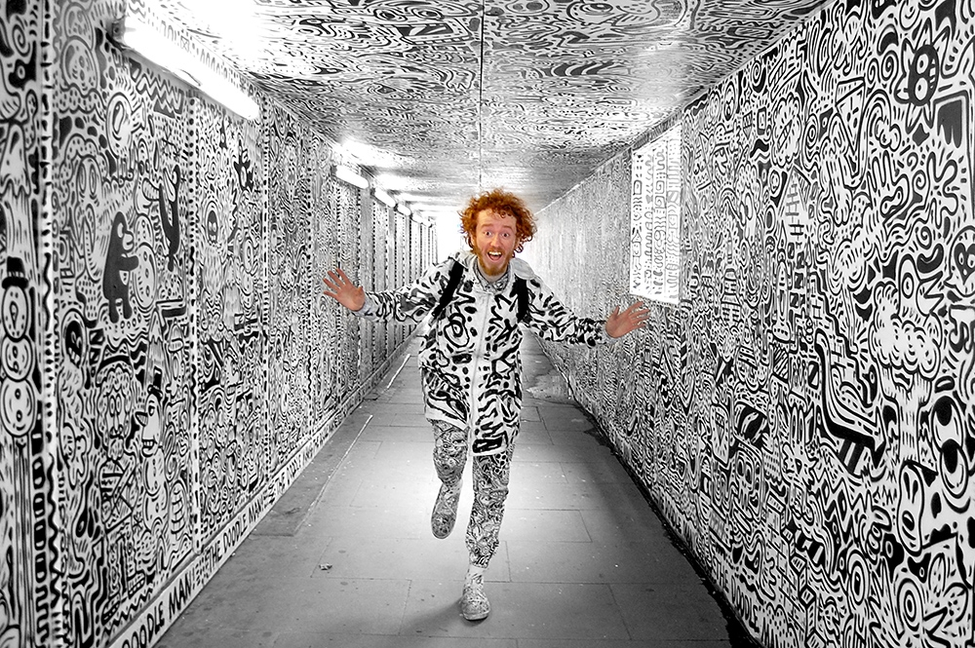
I’m Mr Doodle! But my real name is Sam. I’m 23 years old and I’ve been doodling for as long as I can remember. I have always loved to doodle because I think it is really fun and a very quick and accessible way to express yourself. I doodled over all my exercise books at school and this eventually lead to me doodling over the school walls and bits of furniture too. This has snowballed into my life as ‘Mr Doodle..’

Slide 4
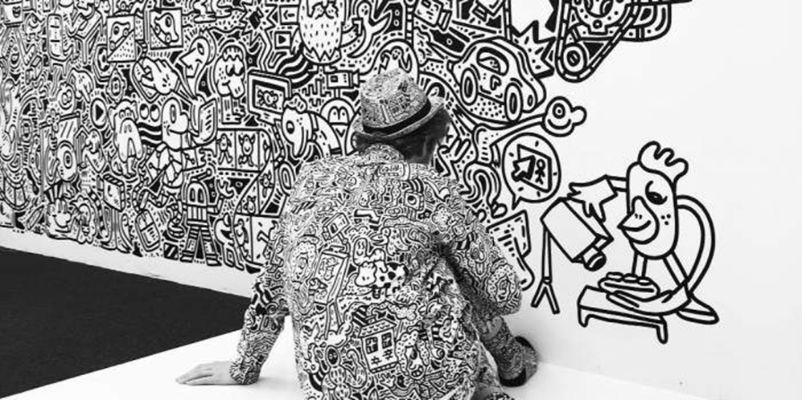
Sam Cox is a 23-year-old artist better known as Mr Doodle, who describes his practice as "OCD – Obsessive Compulsive Drawing". What started out as usual childhood scribbles over everything from school books to his parents’ furniture has since evolved into not only a career but an entirely new universe dubbed – you guessed it – DoodleLand. In interviews with the artist, it’s charmingly hard to tell just how much he believes this place of pure white space and infinite doodling possibilities to be a reality.

Slide 5
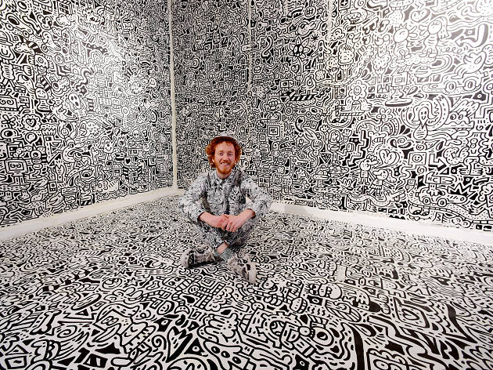
A crazy doodler from England.
His work consumes walls, furniture and many surfaces, almost like a virus and is often described as 'Graffiti Spaghetti'. This is because his clusters of characters, objects and patterns group together in a formation that appears to continue to grow relentlessly.

Slide 6
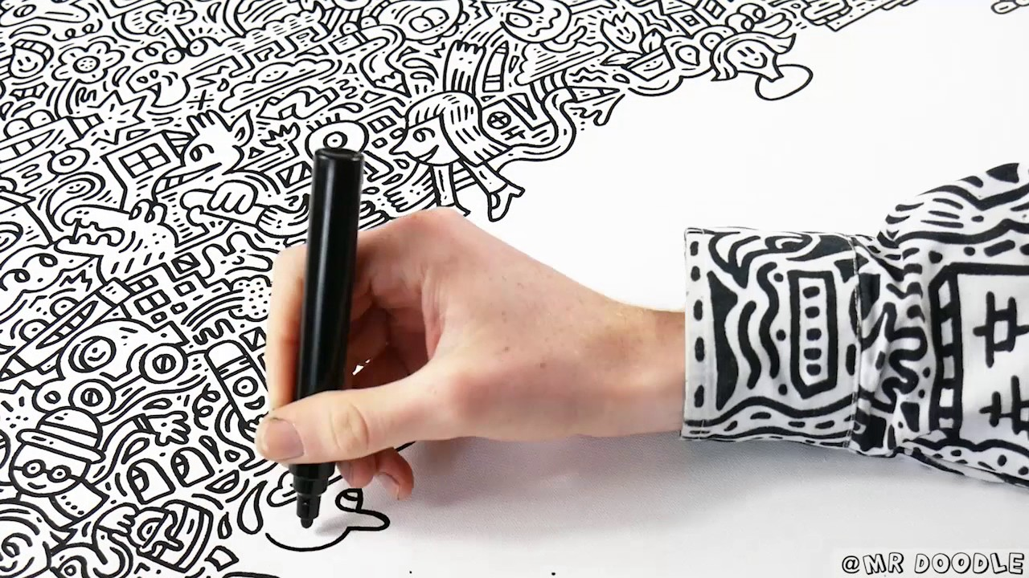

Slide 7
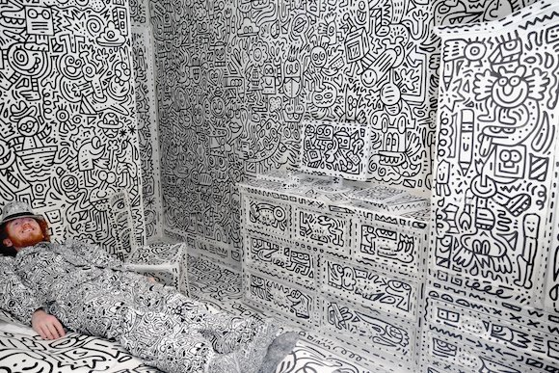
his work is about having fun, and not taking things too seriously. "A lot of art is lacking a sense of humour," says Cox. "It’s a fun thing to be able to draw and create your own world, and sometimes it is funny. I’m not afraid of people laughing at me or if they don’t get it."
His dream project would be something on the scale of a "huge white mansion" or a "DoodleLand theme park, where everything is doodled and there are characters running around,"

Slide 8
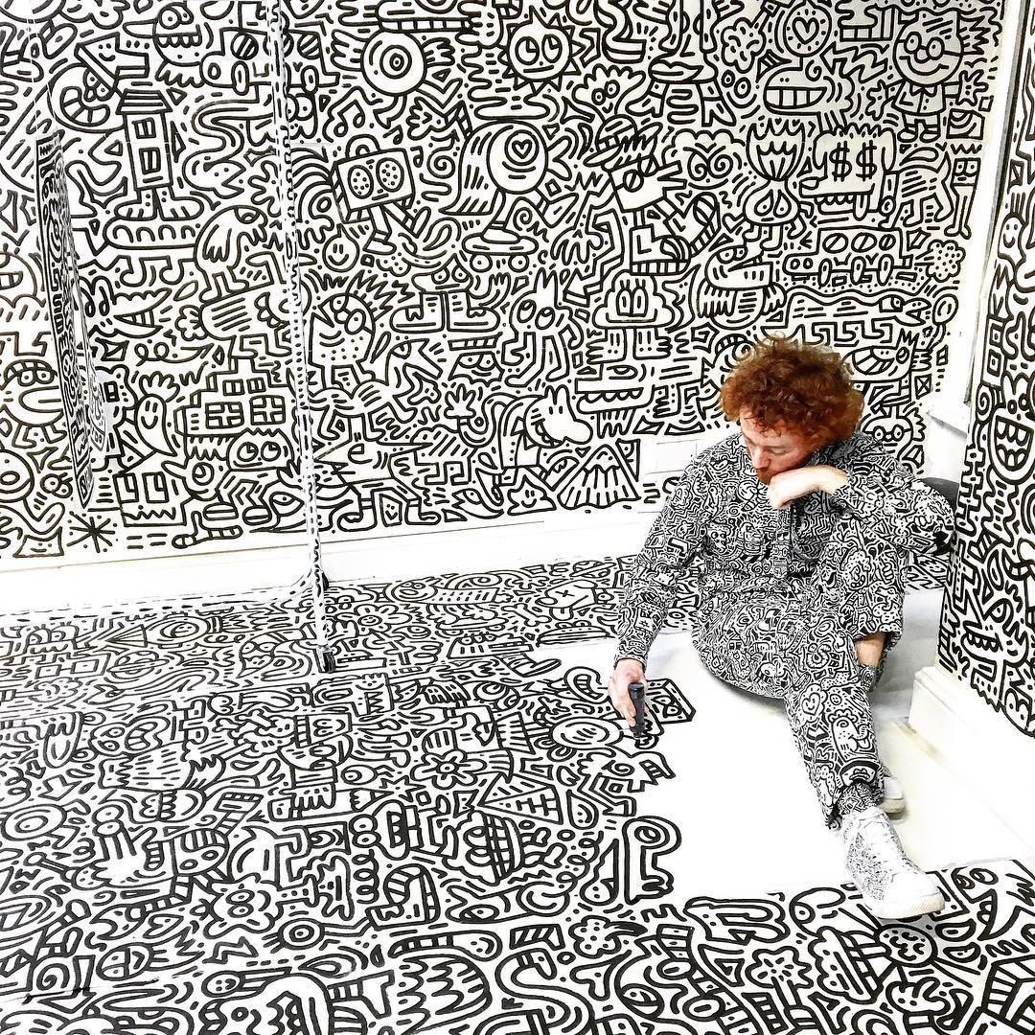
“I love what I do so I do lots of it.
Which usually means 15-16 hours a day of doodling, filming, animating, designing, selling, marketing, branding, e-mailing, everything you can imagine, there’s so much to do.”

Slide 9
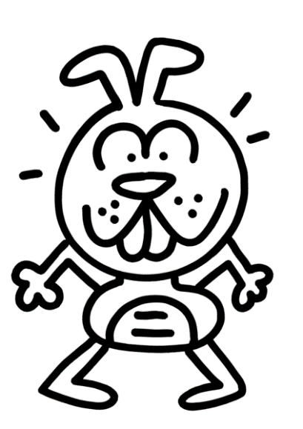
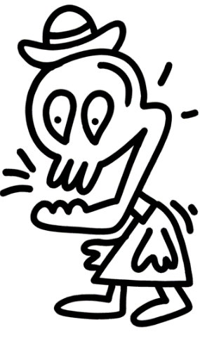
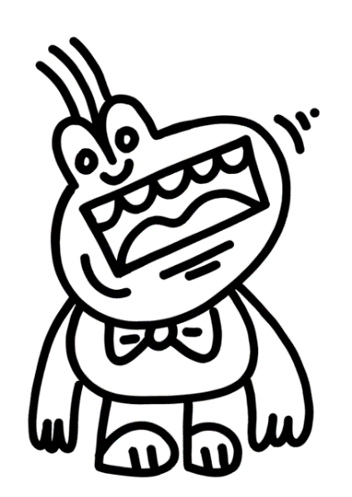
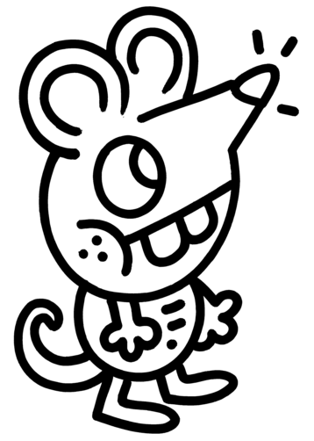
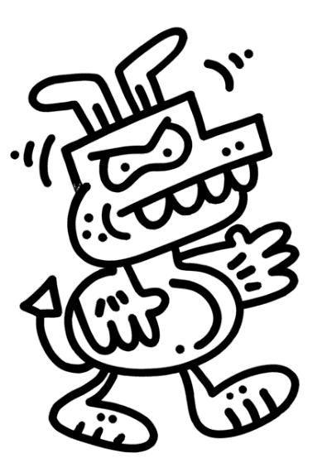
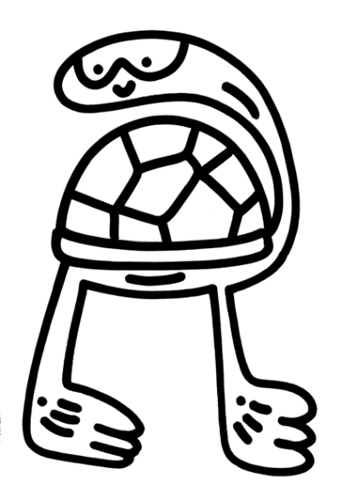
Mr Doodle is UK based artist who’s work features a mixture of characters, objects, and patterns influenced by cereal boxes, video games, and retro cartoons. The result? A quirky, fun, and unique blend of doodle craziness! Mr Doodle began doodling in his sketchbooks as a child, and his rapid doodle craze took him on a fun journey to doodling on all kinds of objects. His work is described as “Graffiti Spaghetti” because it twists and tangles over everything in its path, resulting in pieces of work that have been completely consumed by the ‘Mr Doodle bug!’ You can see most of Mr Doodle’s work in London in the form of murals and installations in people’s homes, offices and in the street.

Slide 10
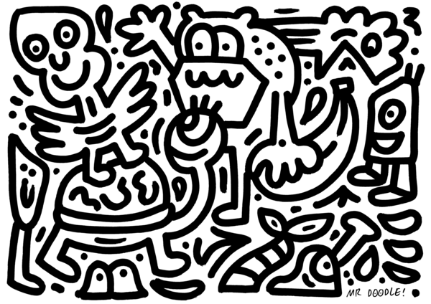

Slide 11
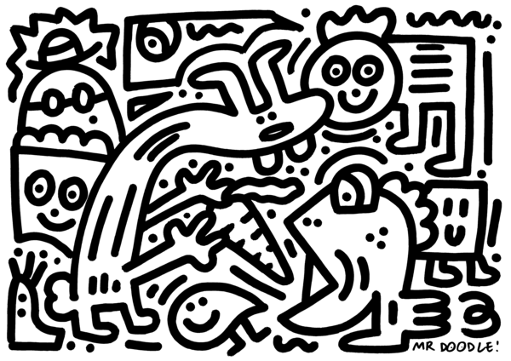

Slide 12
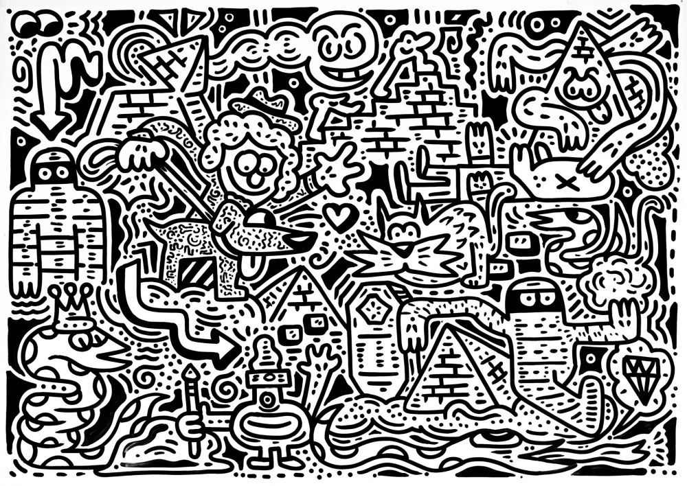
https://petercookphotos.com/2016/07/05/the-doodle-man/#jp-carousel-249

Slide 13
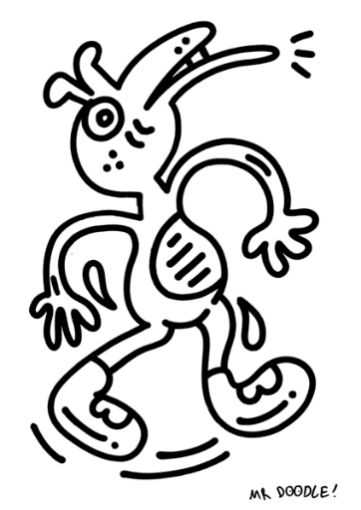
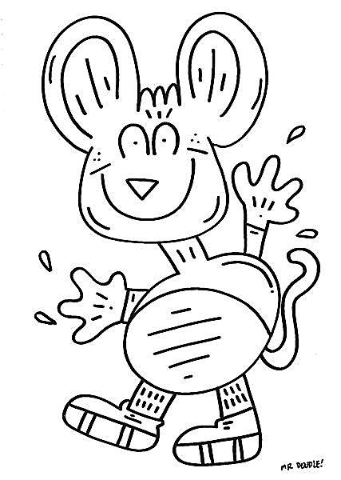
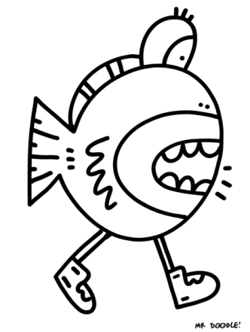
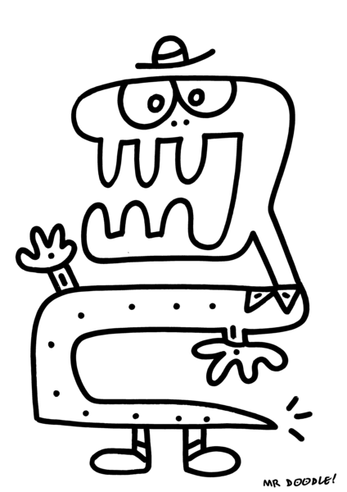
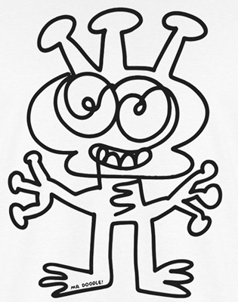
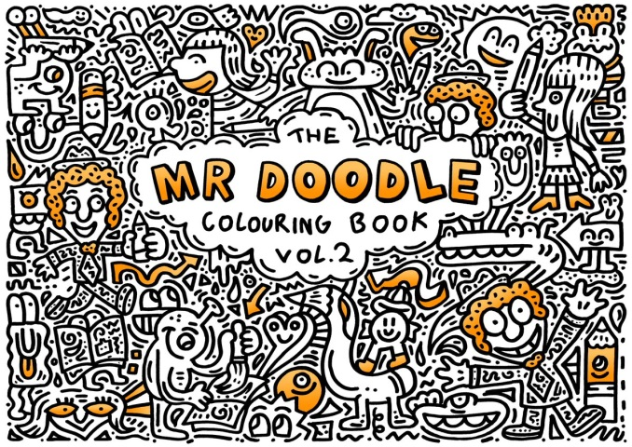
Videos:
Meet Mr. Doodle
https://www.youtube.com/watch?v=1UgQsaC9c6A&list=PL0tbeorjNft-bLDWK18wDIf6zMGbILrXx&index=133&t=0s
Mr Doodle draws The Marvellous Martians from Marshmallow Mountain
https://www.youtube.com/watch?v=cXm05OZvNmc
The Doodle Man Documentary
https://www.youtube.com/watch?v=oMWtRPf5eC4

