Slide 1
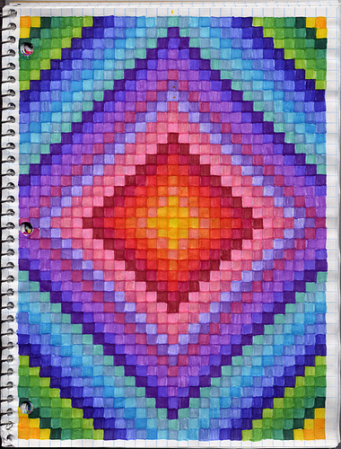
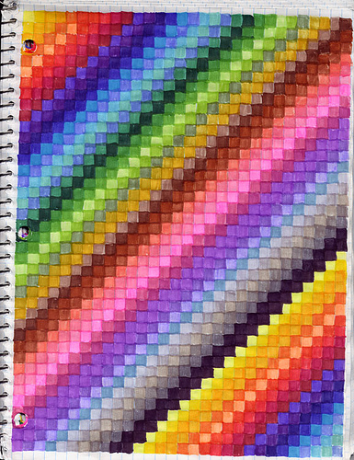

Slide 2
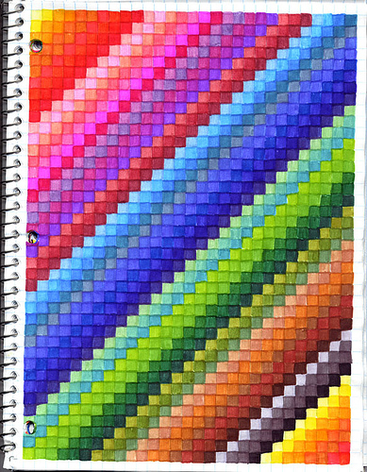
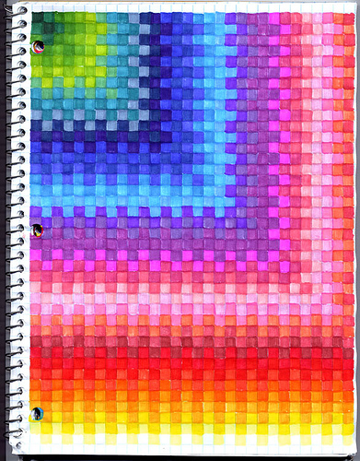

Slide 3
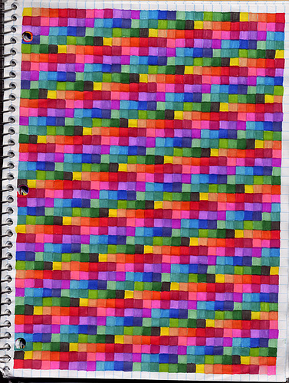
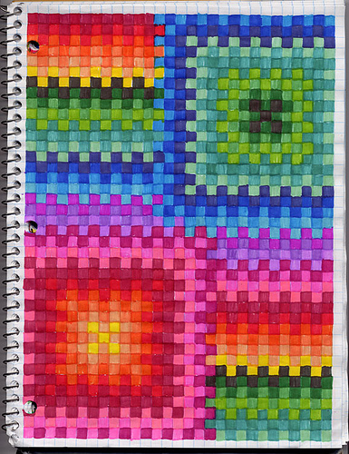

Slide 4
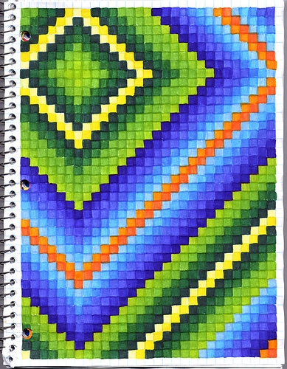
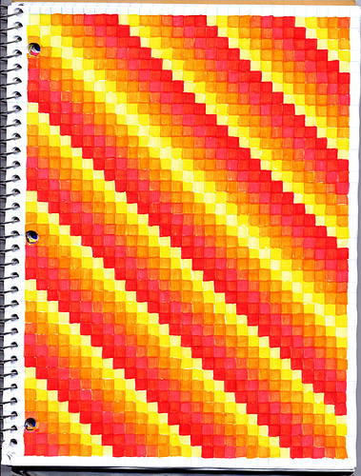

Slide 5
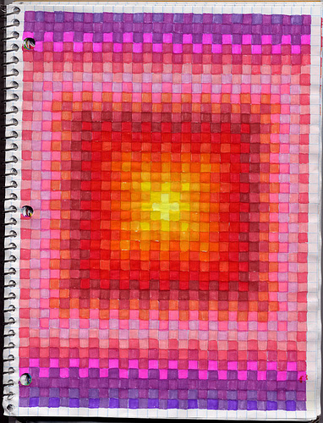
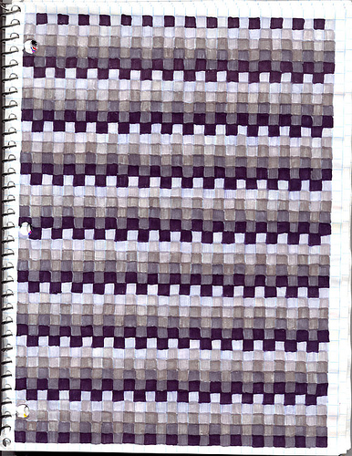

Slide 6
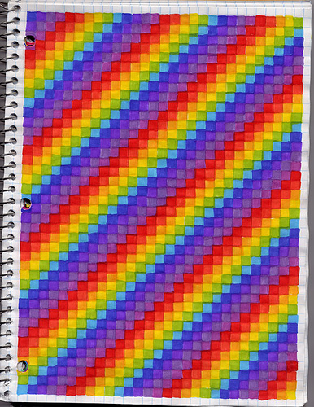
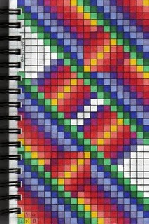
http://www.flickr.com/photos/igeargirl/446875302/in/photostream/

Slide 7
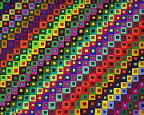
When finished, every square on the graph
paper should be part of a pattern, whether
negative or positive space.

Slide 8
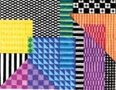
Objectives
• Students will use the pre-printed lines on a sheet of graph
paper as a template for creating their own patterns, therefore
following a simple pre-defined structure
• Students will use a ruler as an art tool (straightedge) and
also as a measuring tool
• Students will apply the design elements of color, shape
and repetition to create patterns
• Students will apply geometry and simple chart making
skills to produce visually intriguing pieces, connecting
mathematic principles of patterning with visual patterning
• Students will create positive and negative spaces and
recognize the difference between them (secondary)
• Students will be able to verbally describe how a pattern is
organized (elementary)
http://www.dickblick.com/lesson-plans/graph-paper-patterns/

Slide 9
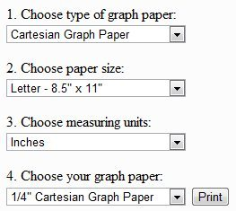
http://www.printfreegraphpaper.com/
http://incompetech.com/graphpaper/

