Slide 1
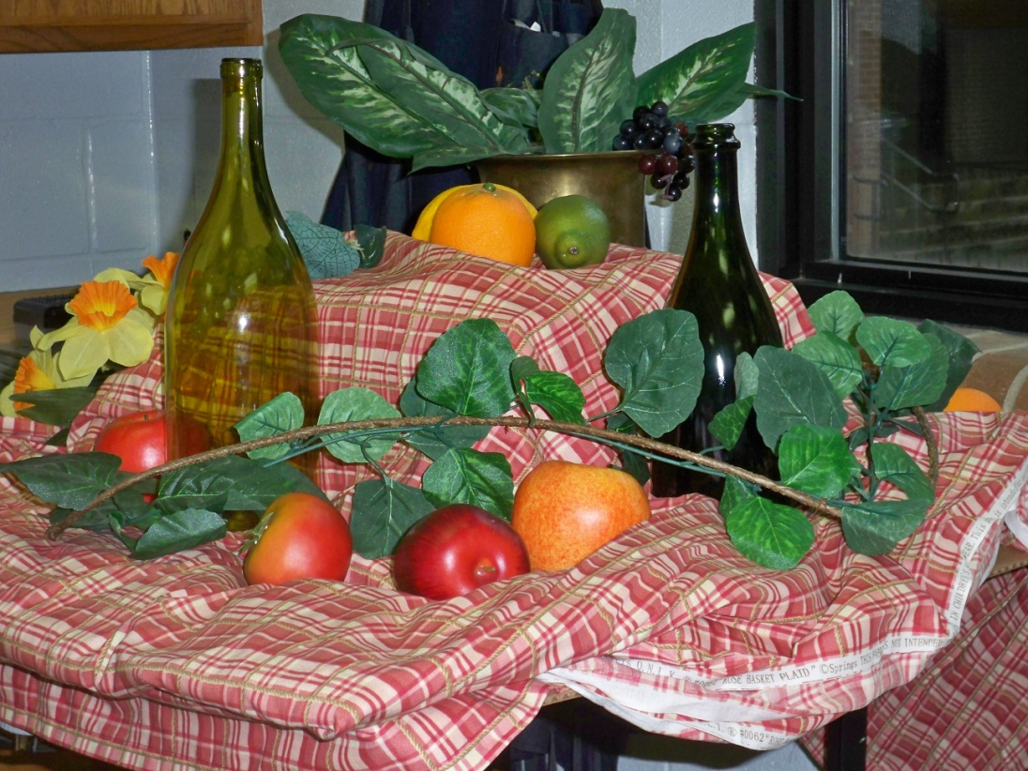
Still Life Drawing
A still life is a work of art depicting mostly inanimate subject matter, typically commonplace objects which may be either natural (food, flowers, plants, rocks, or shells) or man-made (drinking glasses, books, vases, jewelry, coins, pipes, and so on) in an artificial setting.

Slide 2
What have we studied so far?
Value- an element of art that refers to the lightness or darkness of a color.
Texture- is what we use to show how something might feel, or what it is made of.
Negative Space- the space between objects or parts of an object, or around it.
And of course… DRAW WHAT YOU SEE! (TRY NOT TO RELY ON SYMBOLS STORED IN THE BRAIN BUT WHAT IS ACTUALLY IN FRONT OF YOU)

Slide 3
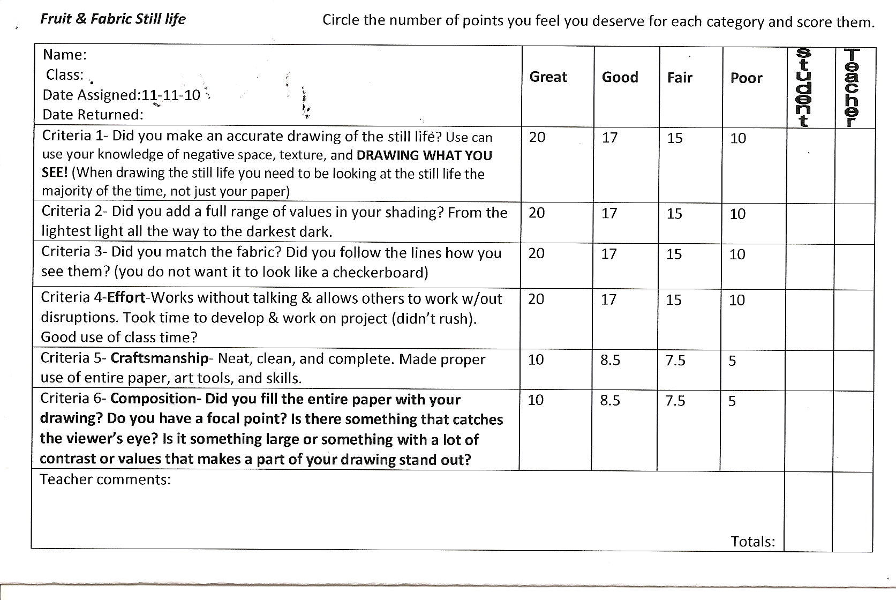
Requirements:

Slide 4
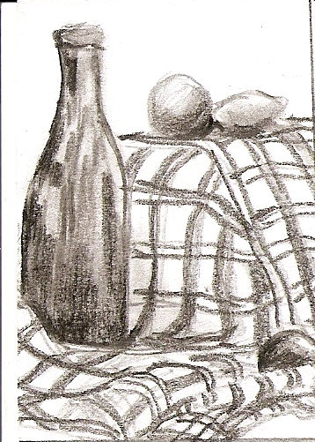
Fill the Paper

Slide 5
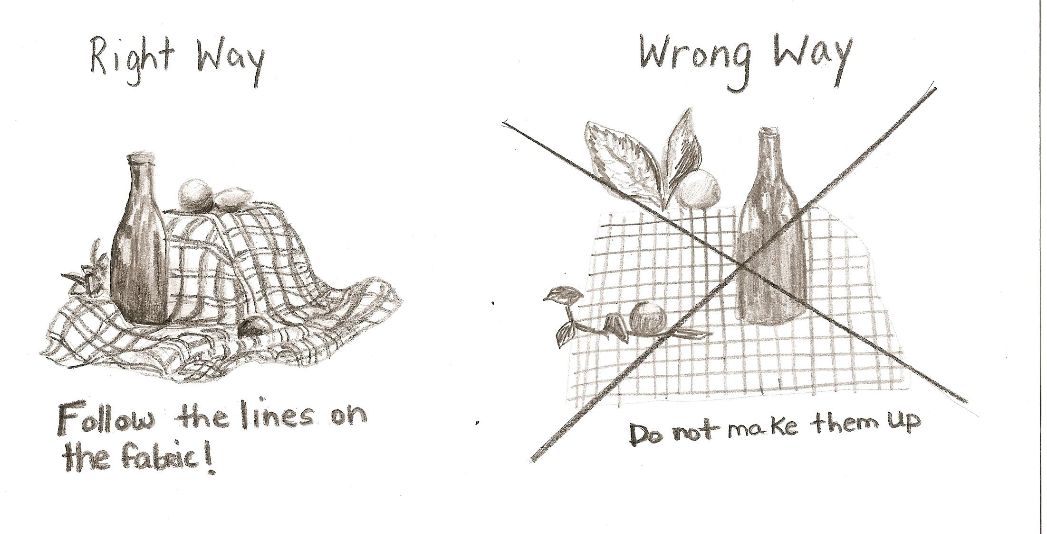
LINES in the FABRIC

Slide 6

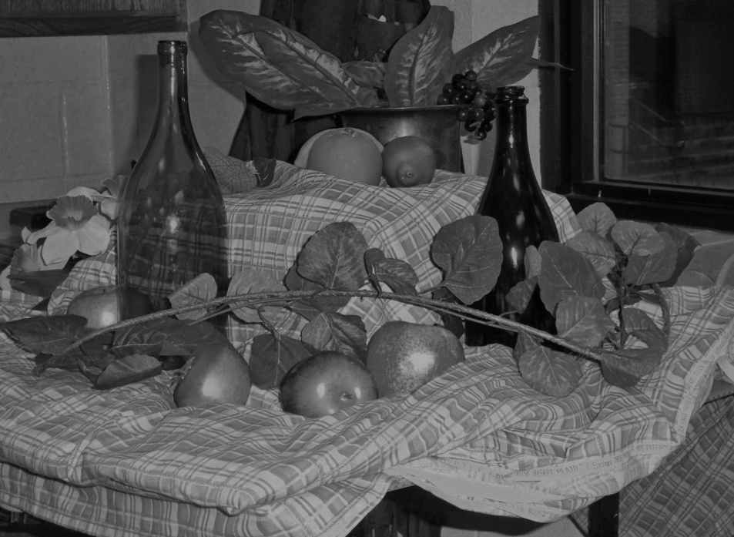
Match the Values
Where it’s dark, shade dark, where it’s light, leave it light, and all the values in between!

Slide 7
You will do some thumbnail sketches first, to get the most interesting composition. Let me know when you have a good one for me to check and then you can begin.
Make sure you are somewhere you can see and be sure to stay on task. Your grade will be lowered if you do not use good work ethic!
I’m expecting greatness!

Slide 8
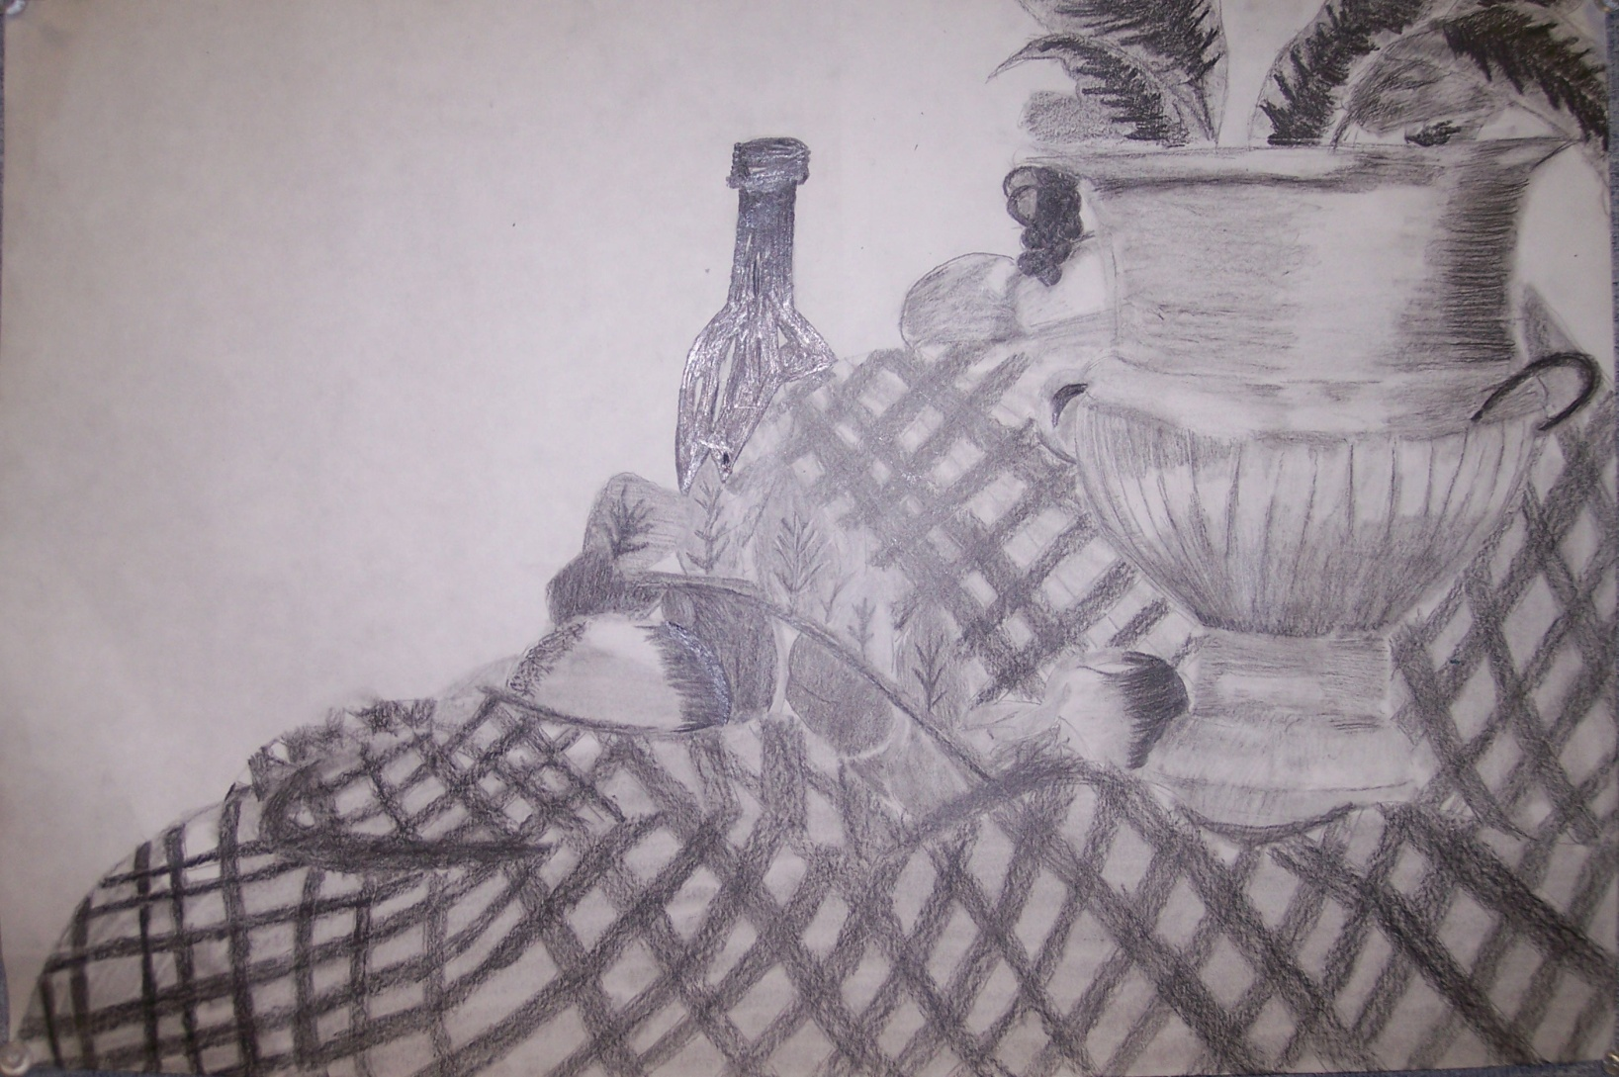
Student examples:

Slide 9
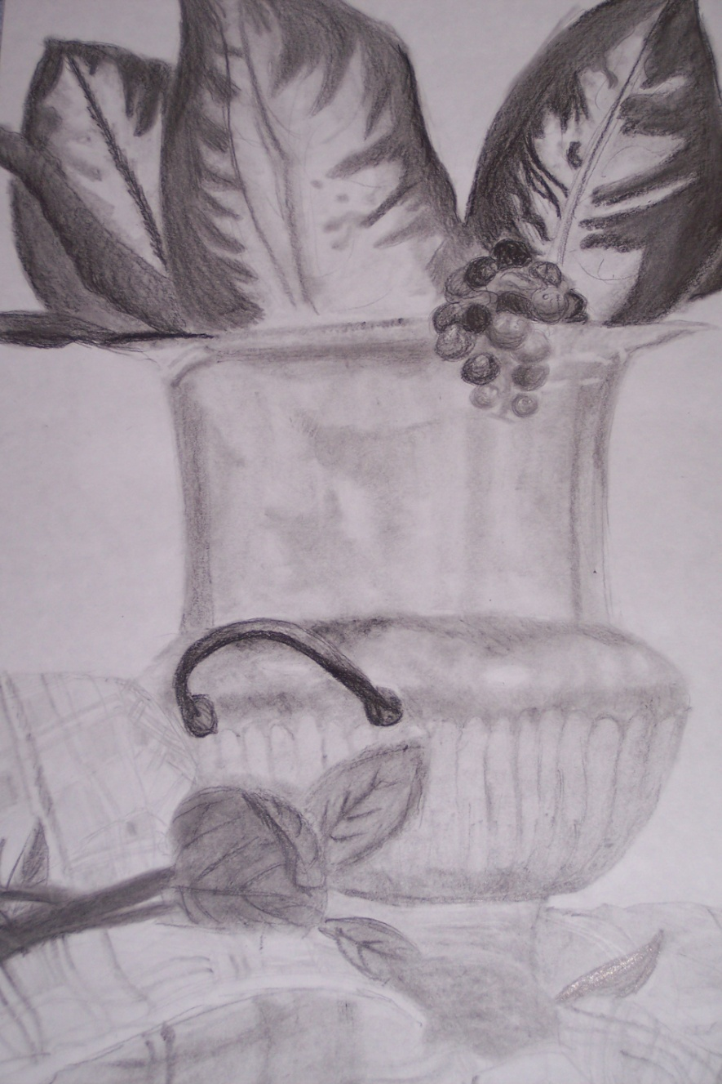

Slide 10
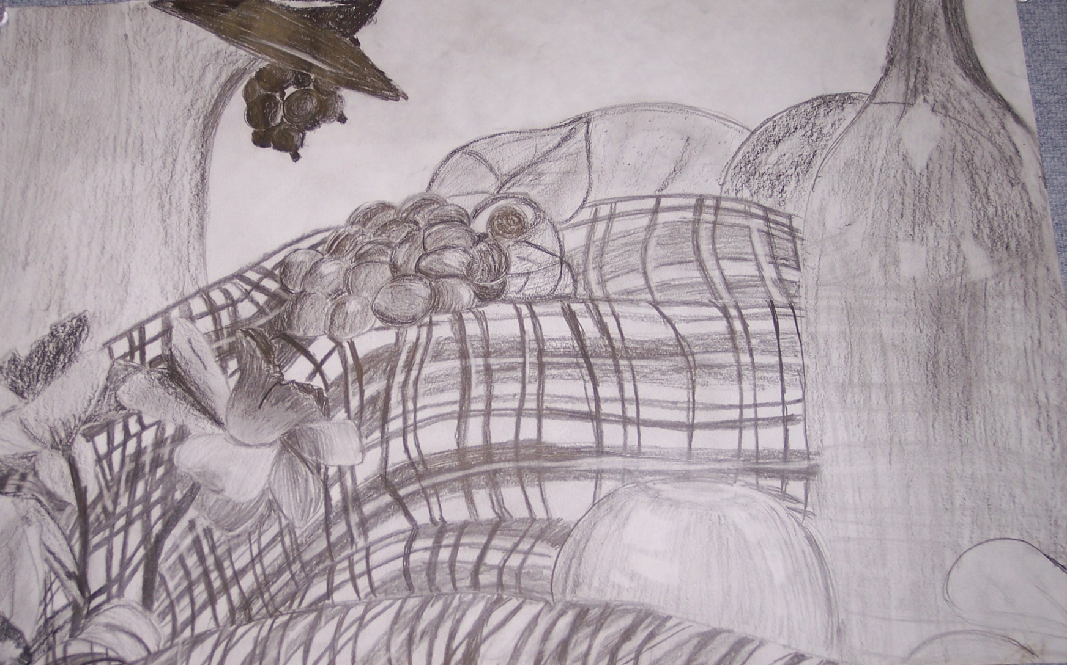

Slide 11
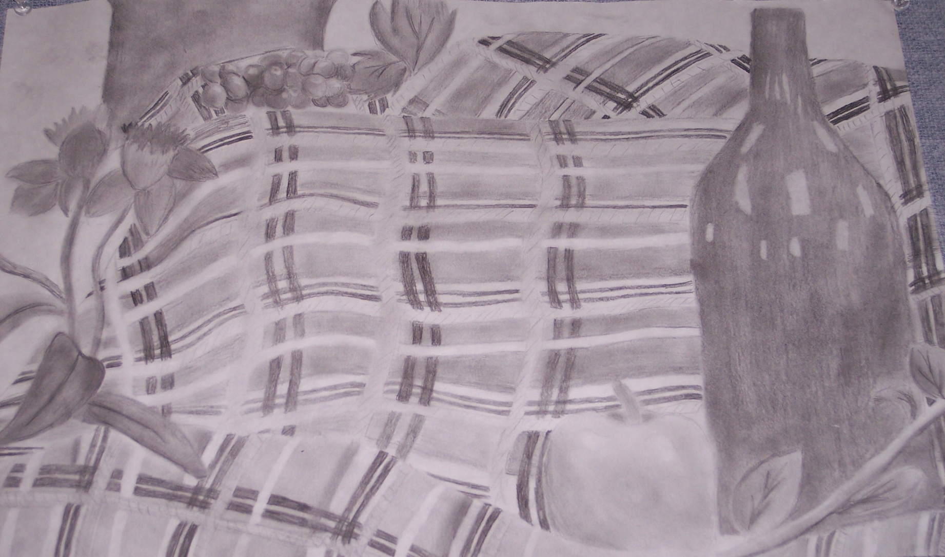

Slide 12
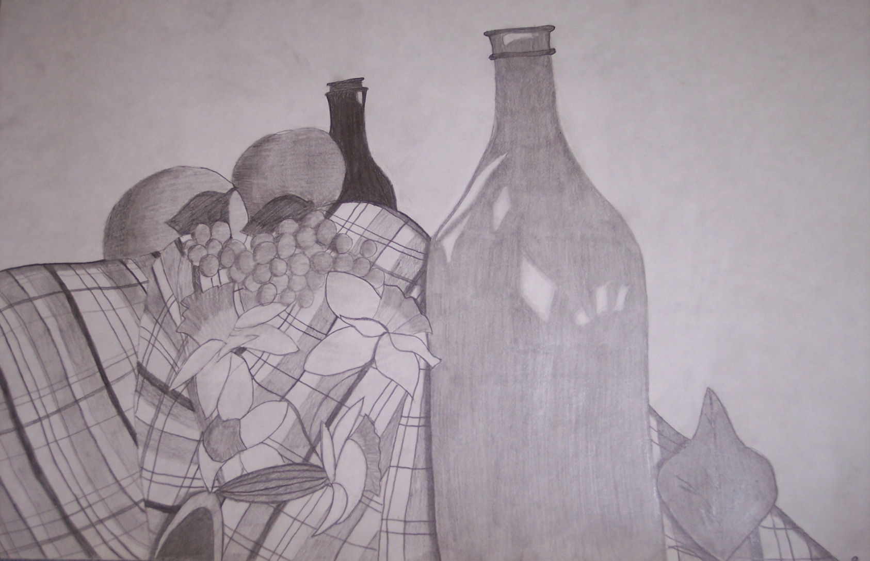

Slide 13
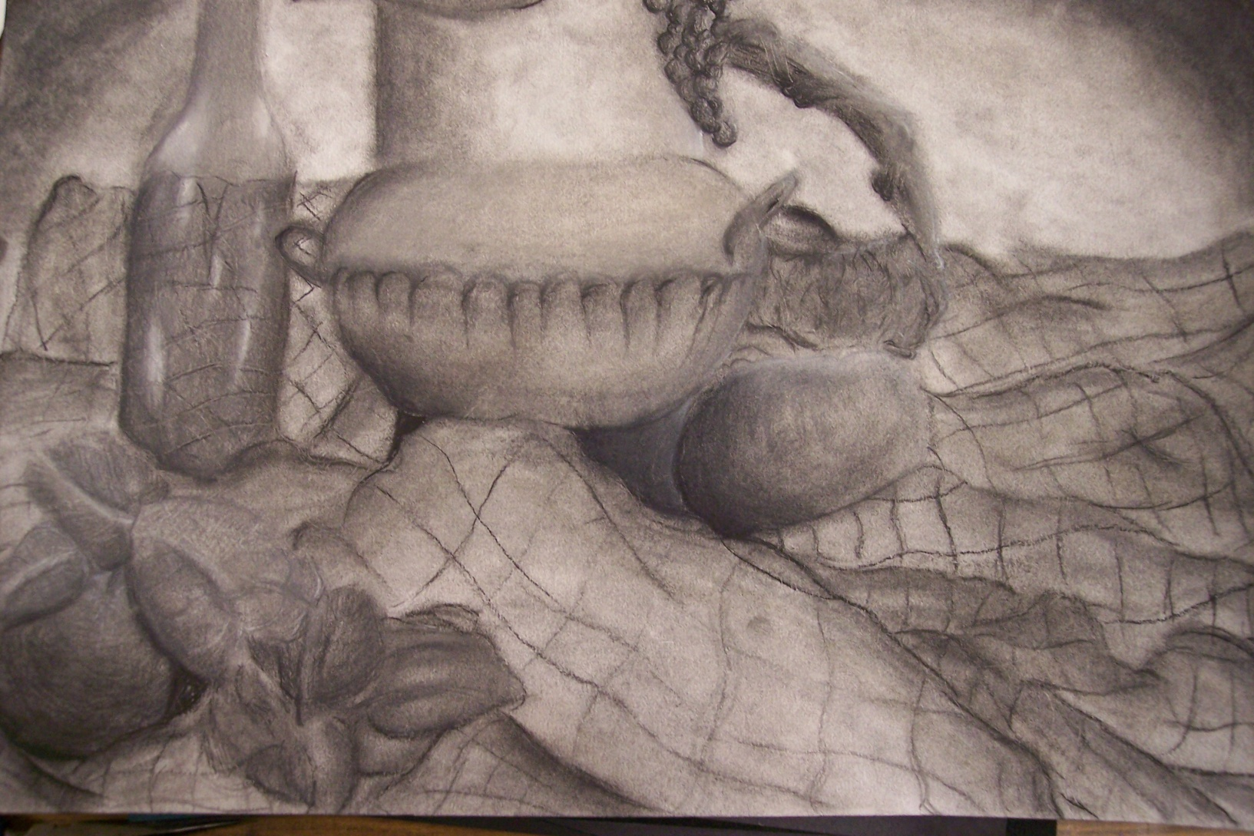

Slide 14
