Slide 1
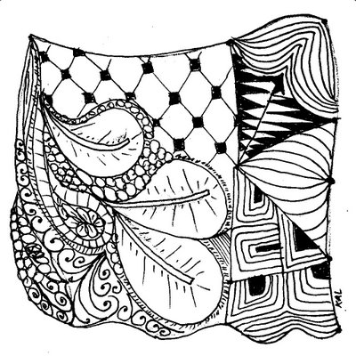
Zentangles
We will be incorporating Zentangles into our first project
You will practice the Zentangle Technique before you apply it to your artwork

Slide 2
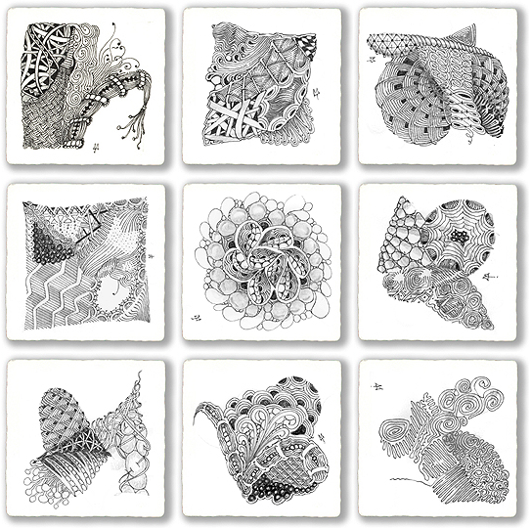
Zentangles
A Zentangle is an abstract drawing created by using repetitive patterns.
It is usually structured within a certain shape.
Drawing a Zentangle is entertaining, relaxing, and a great way to express yourself creatively.

Slide 3
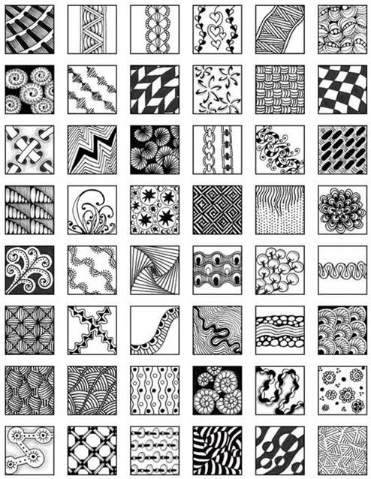
Zentangles can be inspired by many things.
Nature, wildlife, inanimate objects… the possibilities are endless.
Even though they are inspired by these things, they are abstract and are not specific drawn objects.
Notes:
Tangles can be inspired by many things. Nature, wildlife, inanimate objects… the possibilities are endless. Often, Zentangle artists name their tangles. Can you tell what some of tangles are inspired by?
3

Slide 4
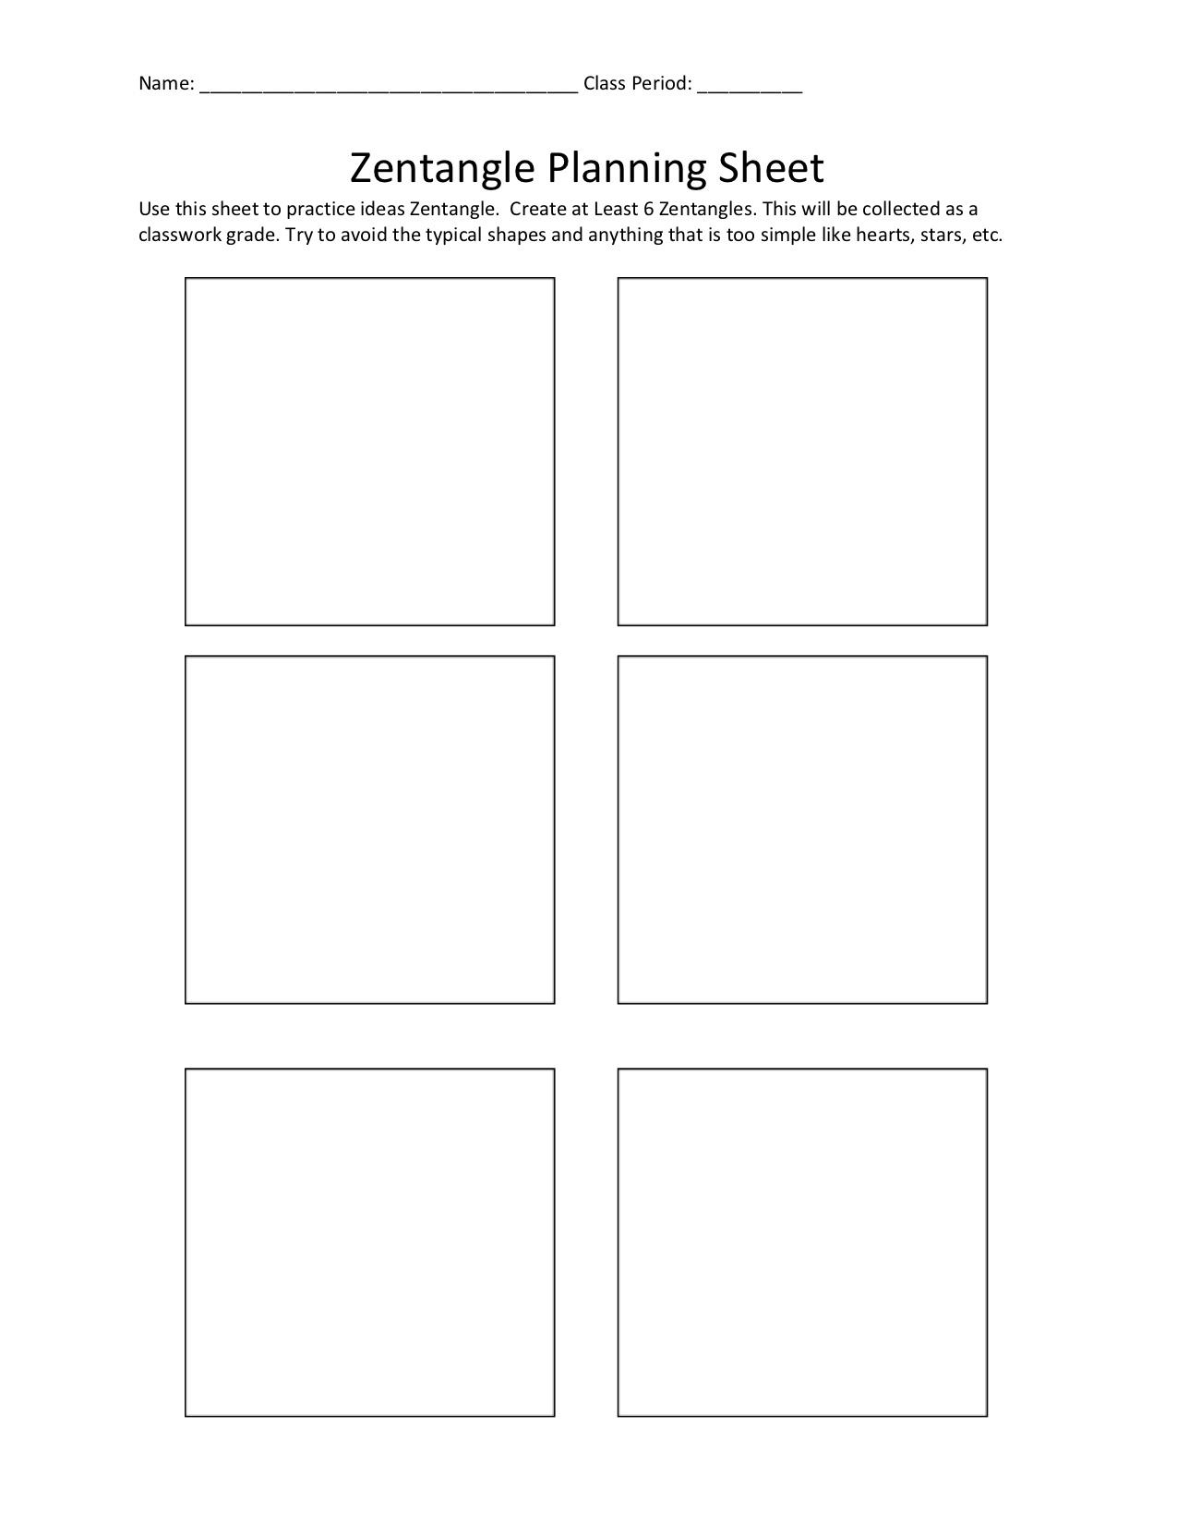
You will be practicing Zentangles on a practice sheet
Practice at least 6 different Zentangles.
This practice sheet will be handed in for points.
Notes:
4

Slide 5
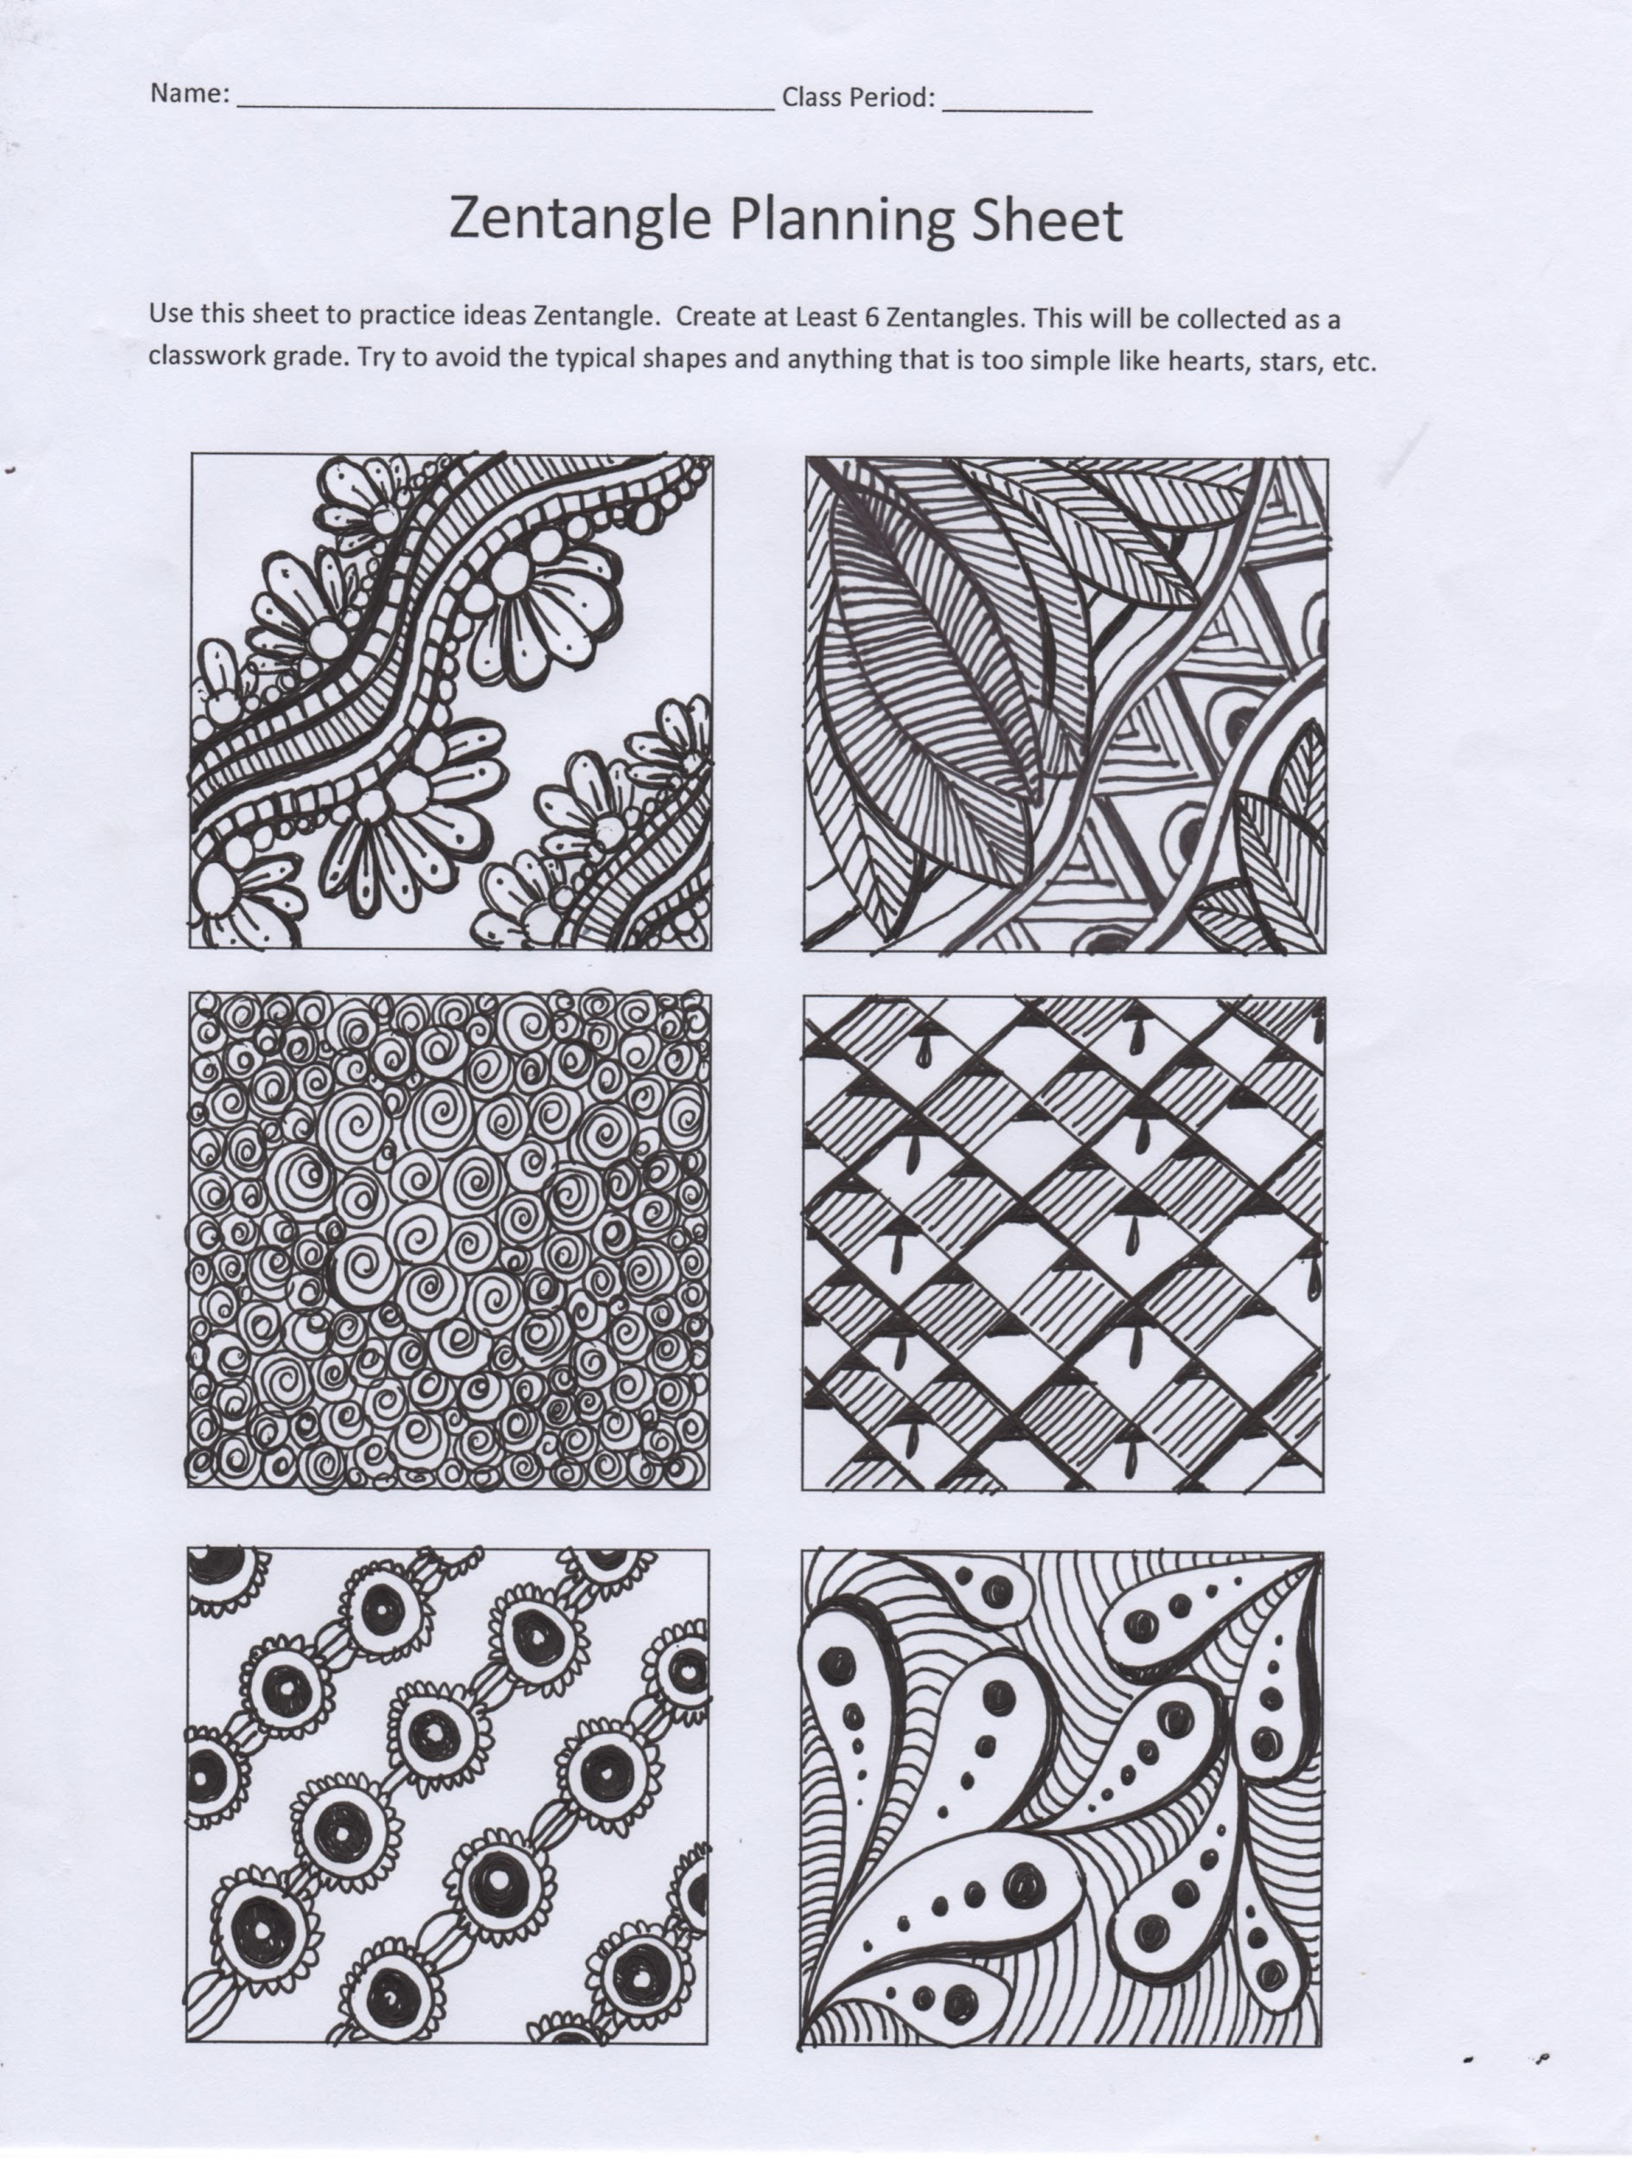
You can use pencil, but using a black thin marker is recommended to help you commit to your lines and designs
If you mess up, just go with it!!
NO WHITE OUT!!!!!!
Notes:
5

Slide 6
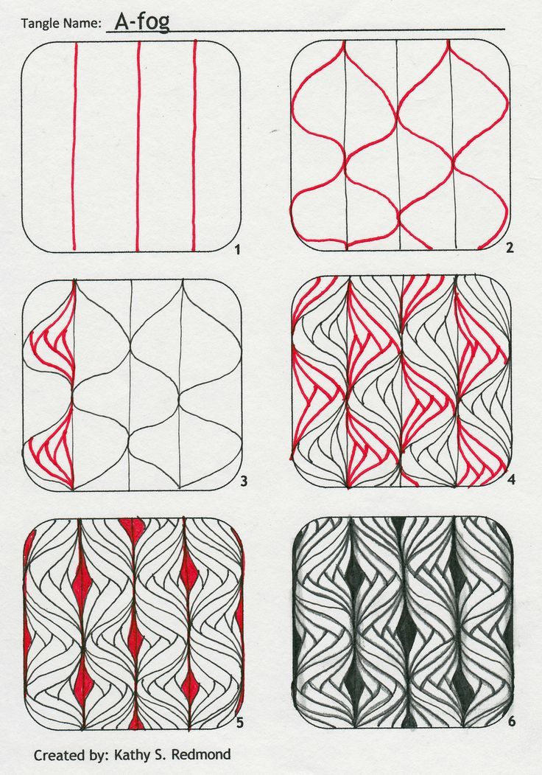
Tips for Zentangles:
Let it flow
It’s not Perfect
DO NOT USE A RULER!!
You can google Zentangle examples or How-to Zentangle
There are MANY examples is this slideshow to inspire you
Notes:
6

Slide 7
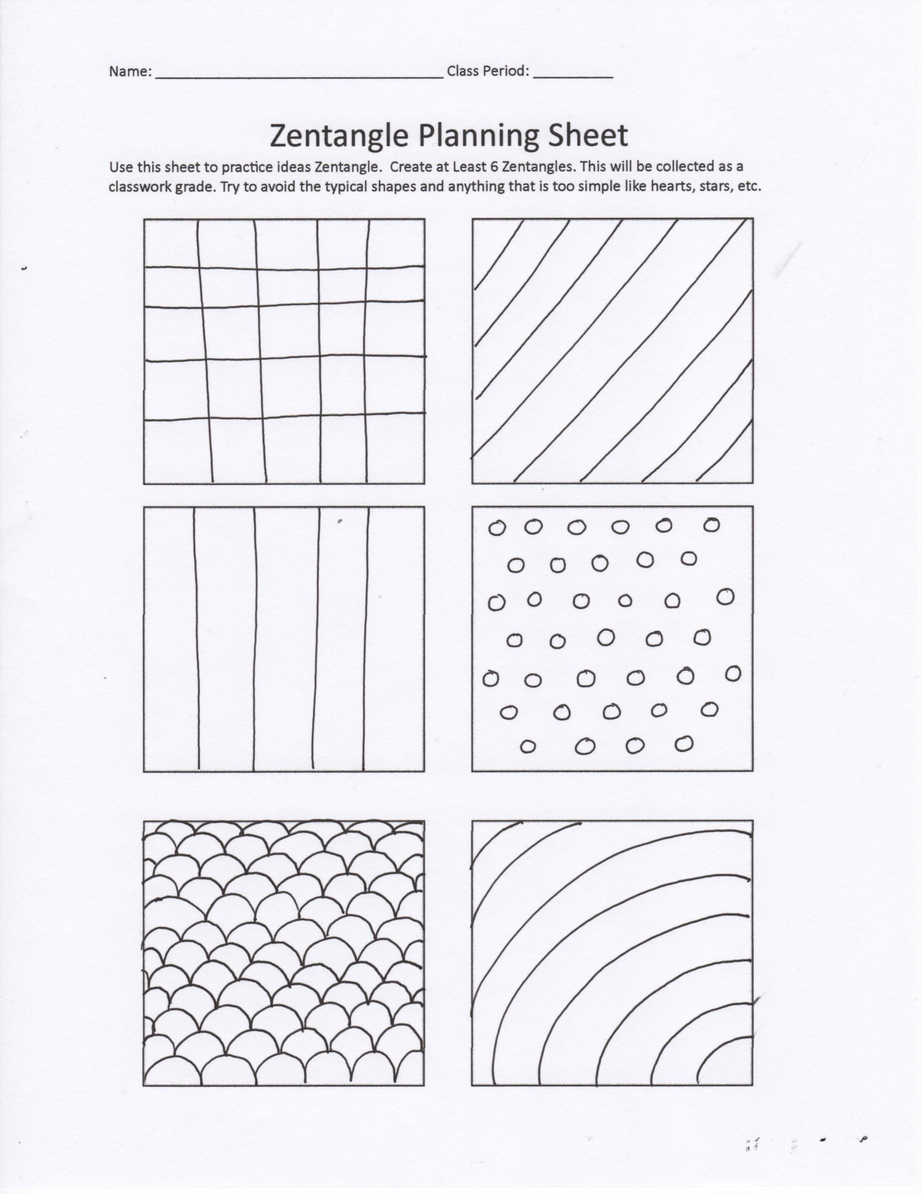
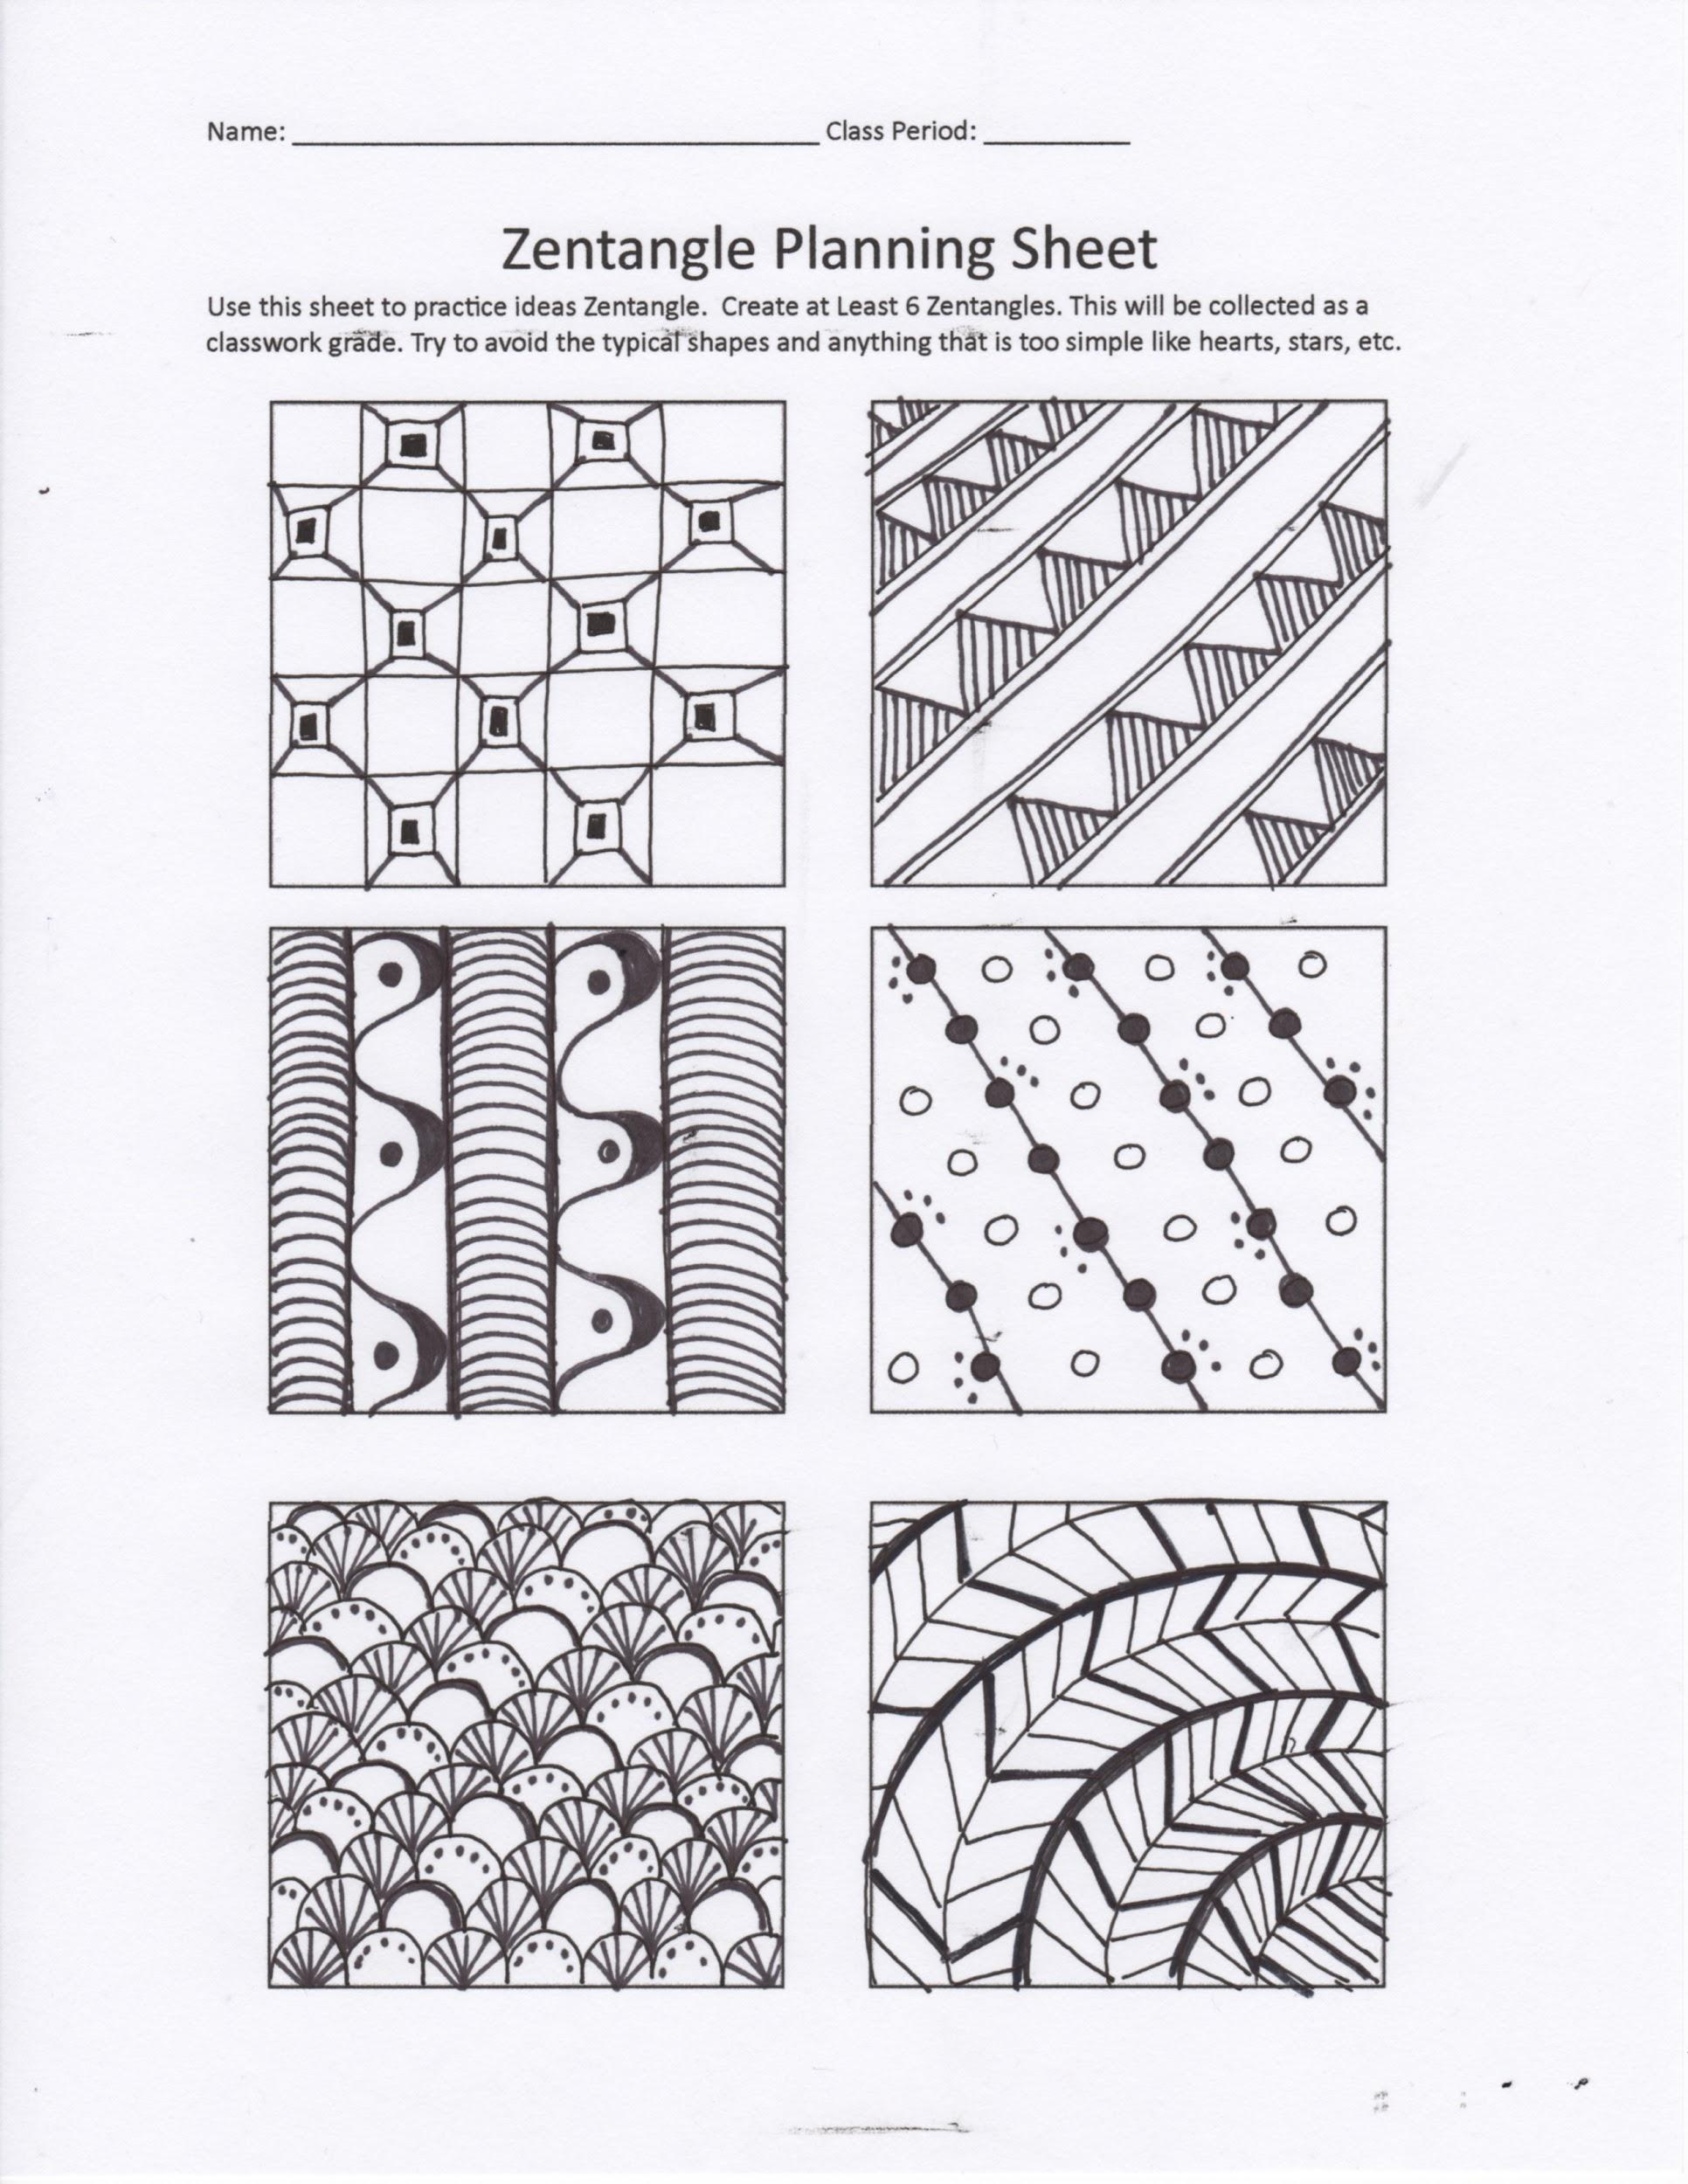
I am looking for time and effort - no rushing
NO!!! TOO SIMPLE!!
YES!! LOTS OF DETAILS
Notes:
7

Slide 8
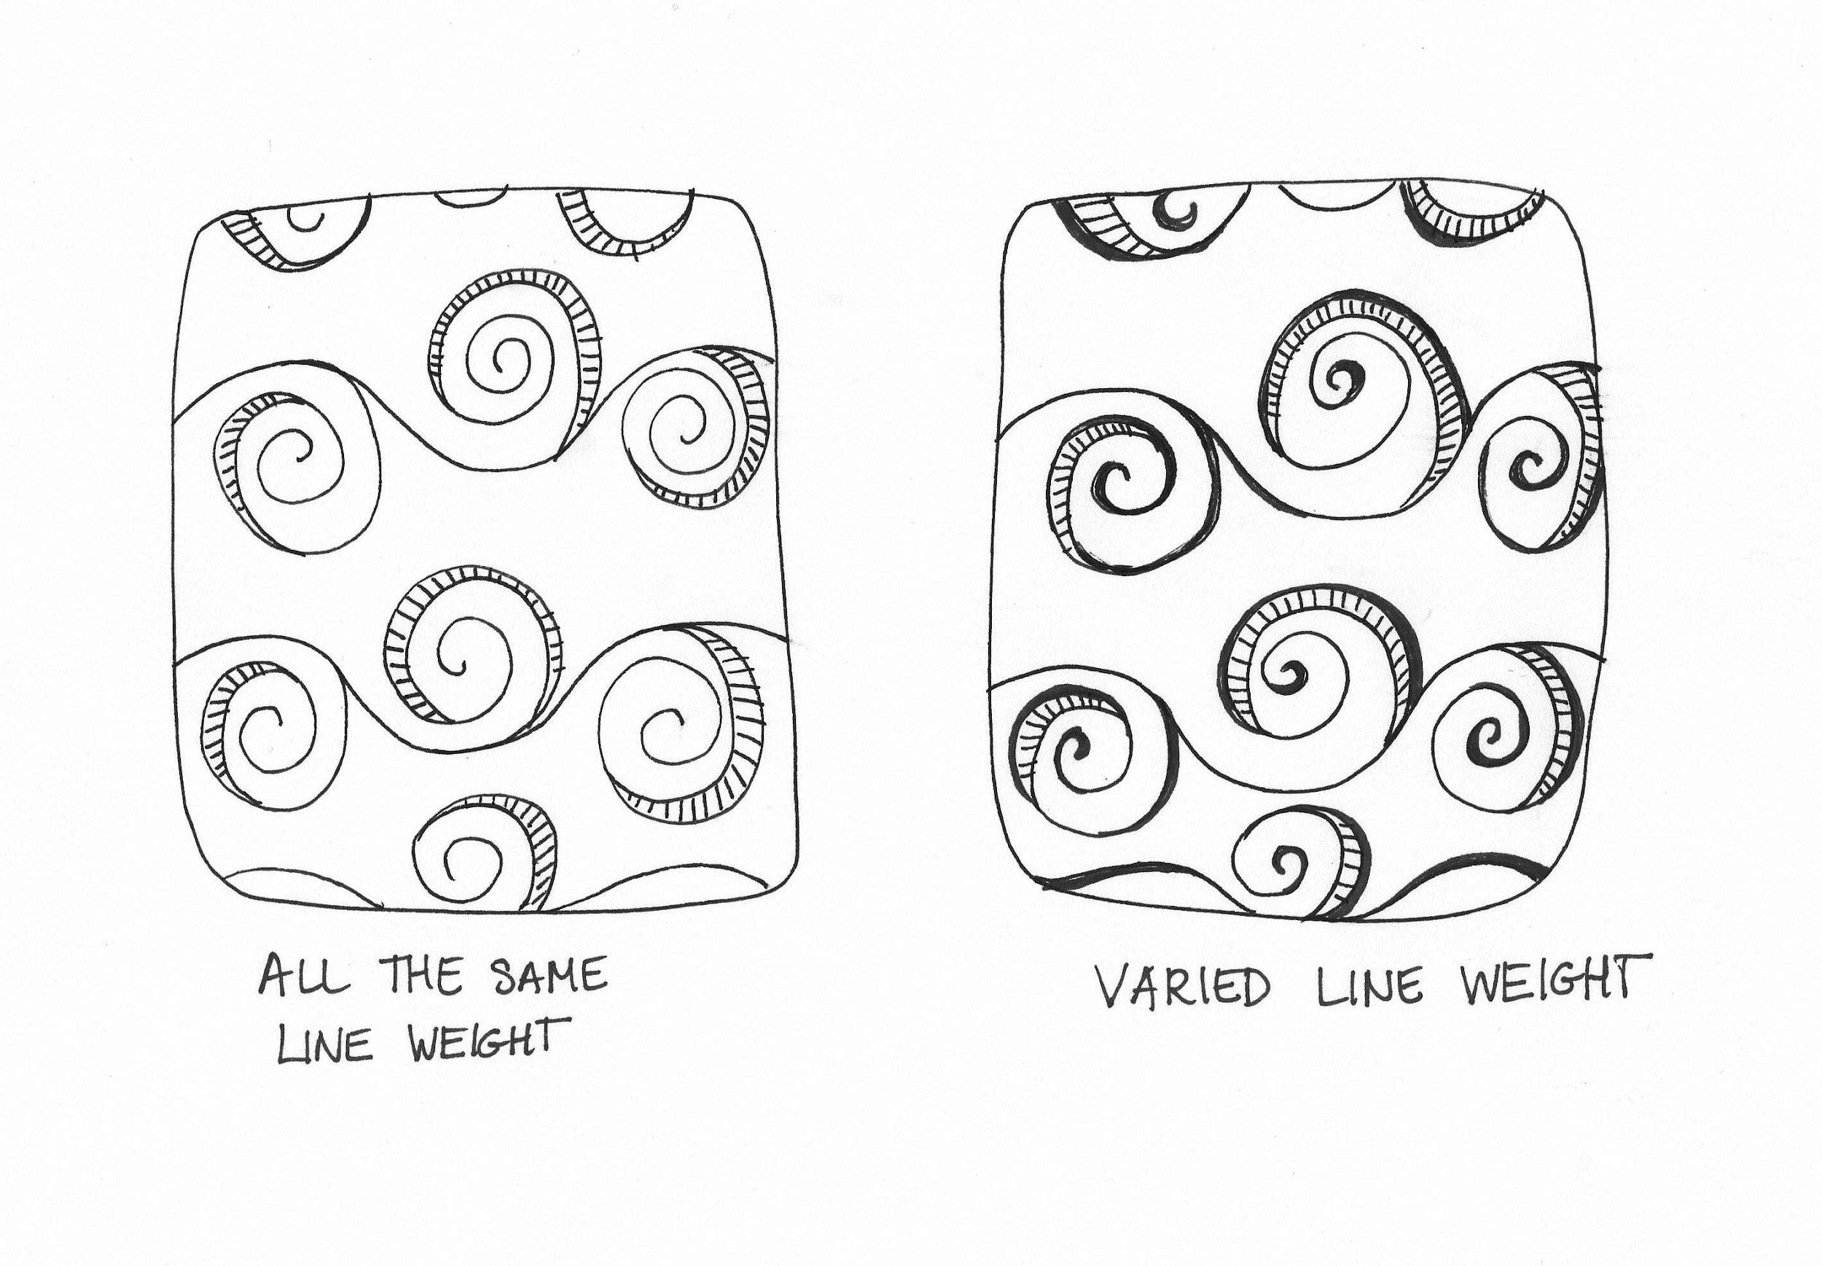

Slide 9
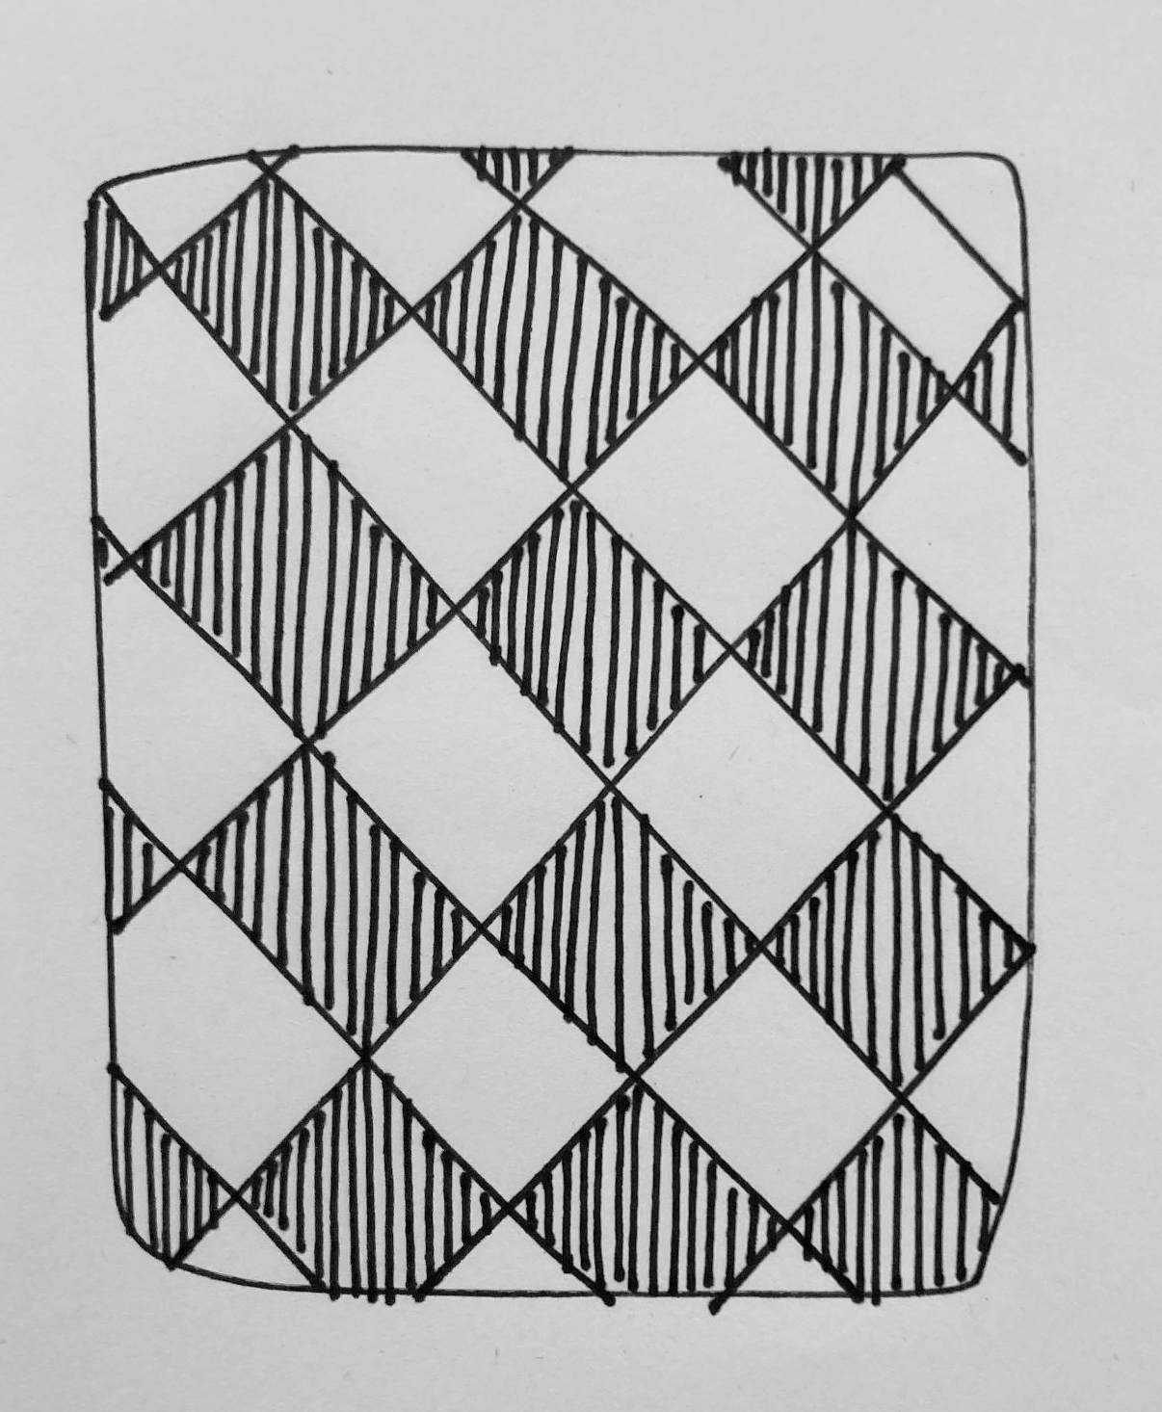
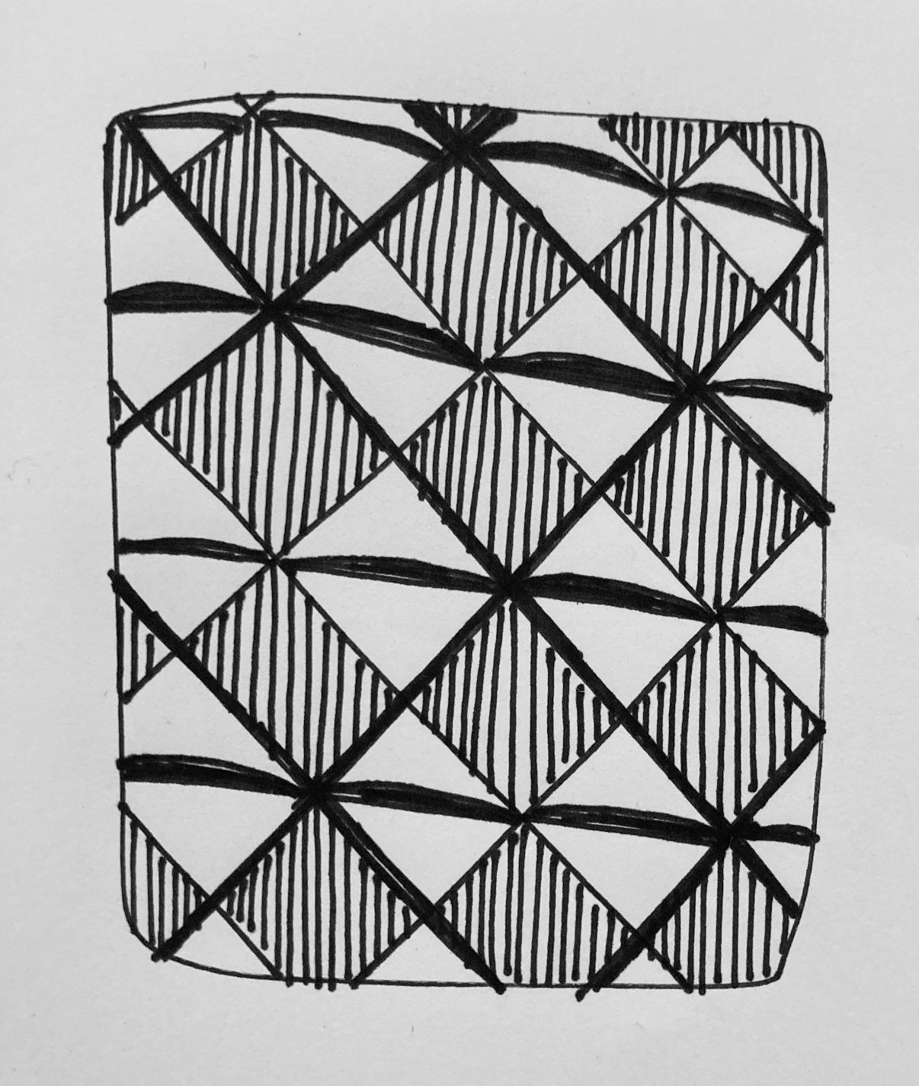
All the same line thickness
Same drawing with added thick lines

Slide 10
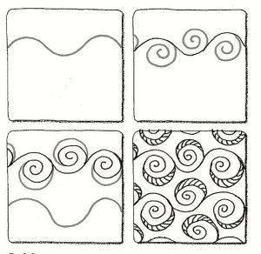
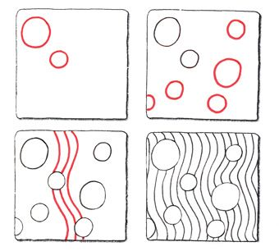

Slide 11
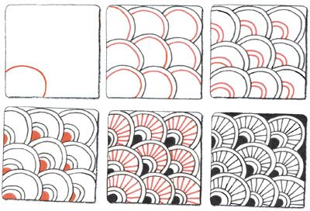

Slide 12
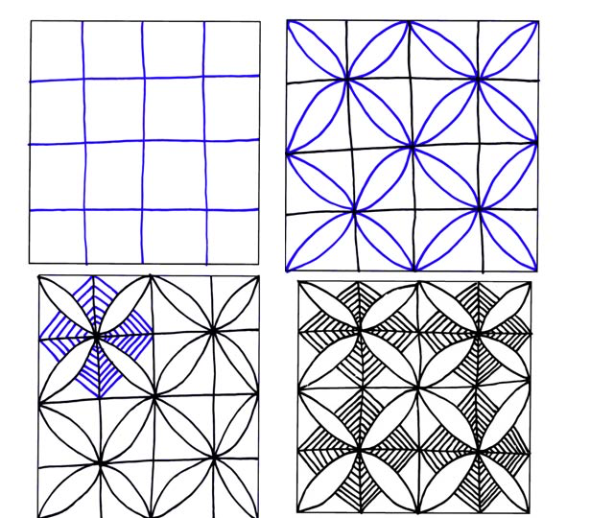
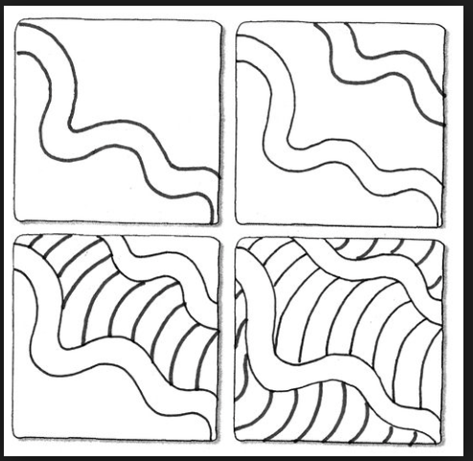

Slide 13
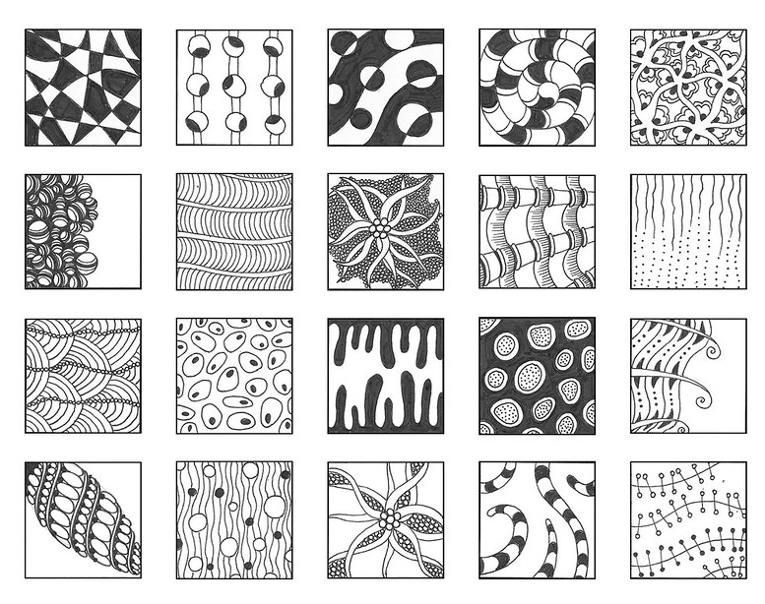

Slide 14
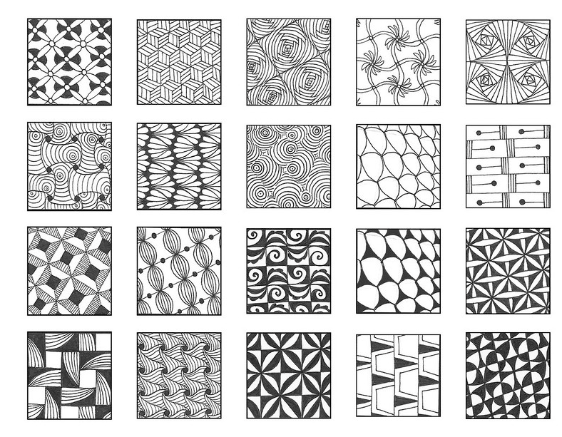

Slide 15
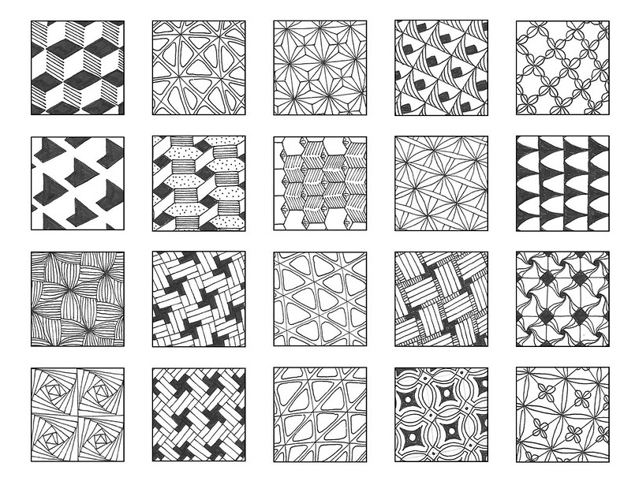

Slide 16
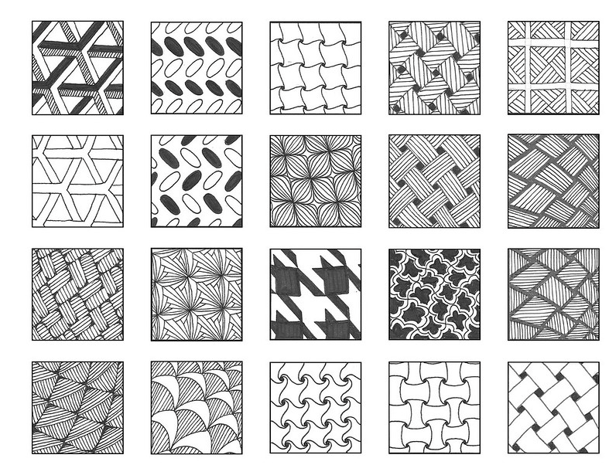

Slide 17
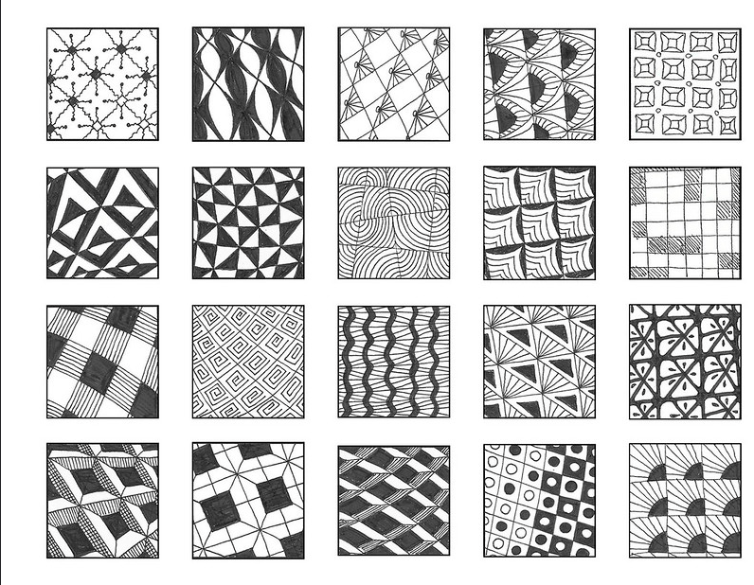

Slide 18
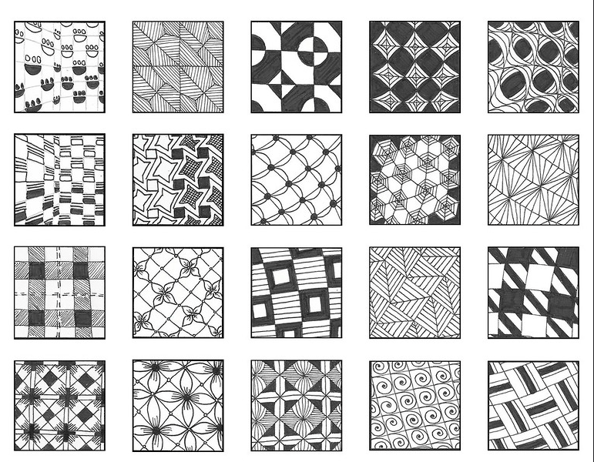

Slide 19
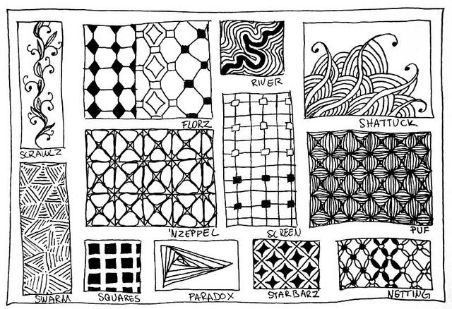
Notes:
19

Slide 20
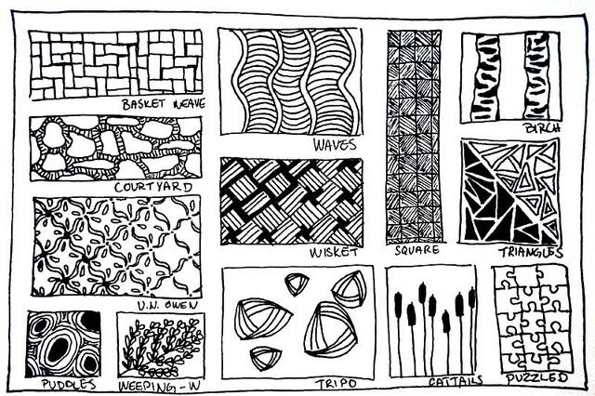
Notes:
20

Slide 21
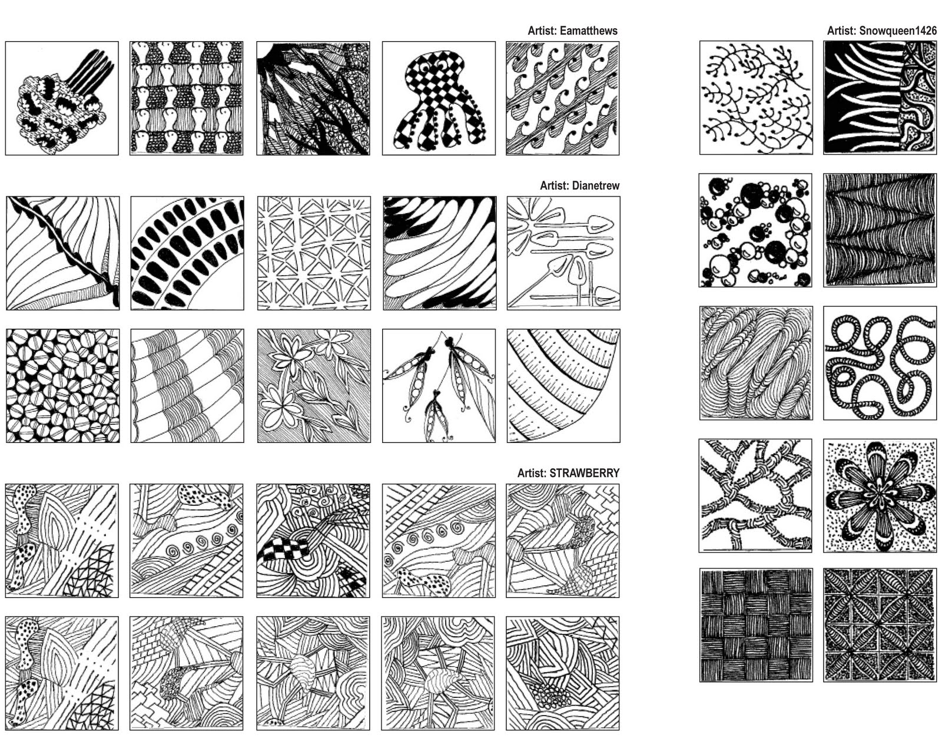
Notes:
21

Slide 22
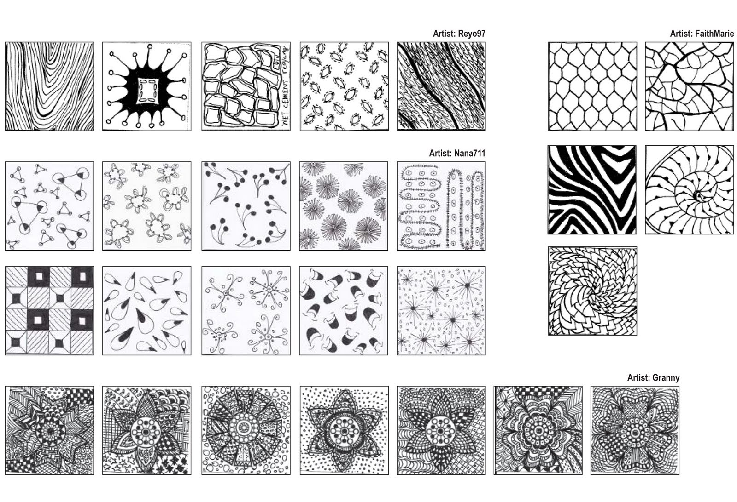
Notes:
22

